Slide 1
Class Templates array and vector; Catching Exceptions
Chapter 7 of C++ How to Program, 10/e

Slide 2
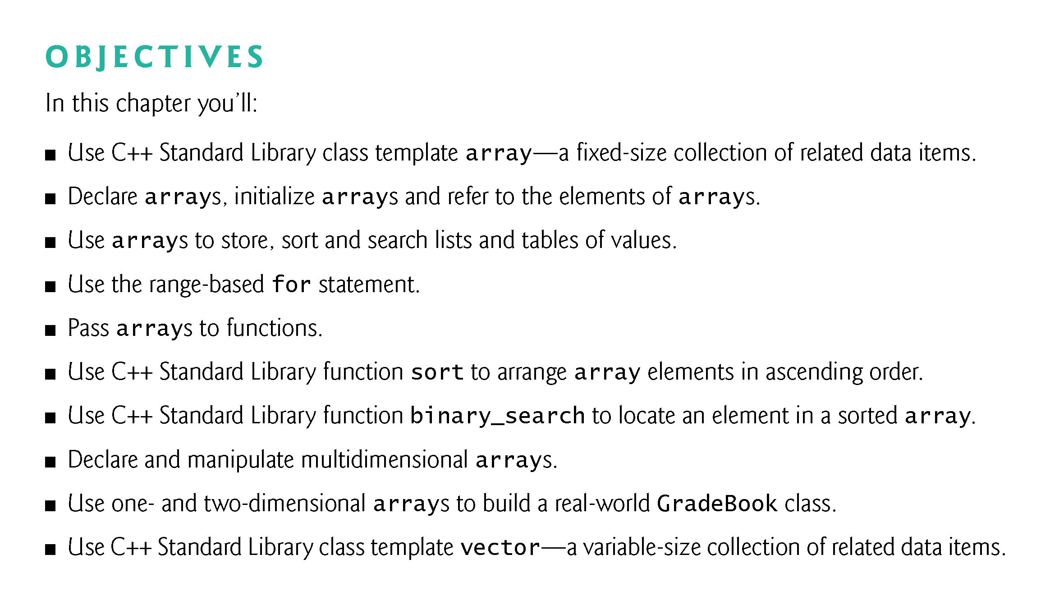

Slide 3
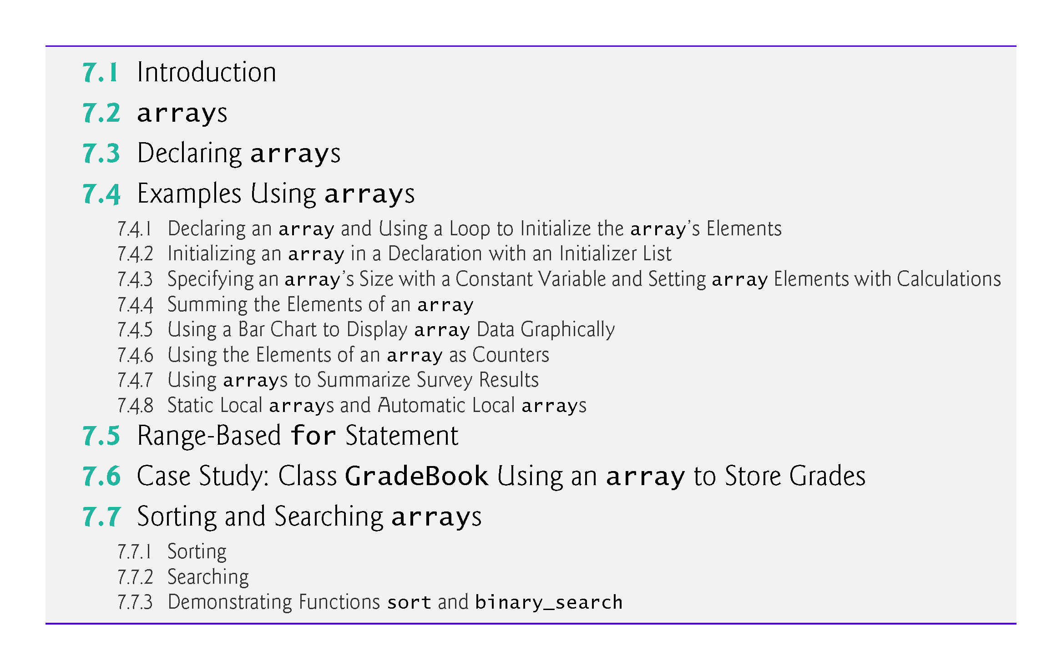

Slide 4
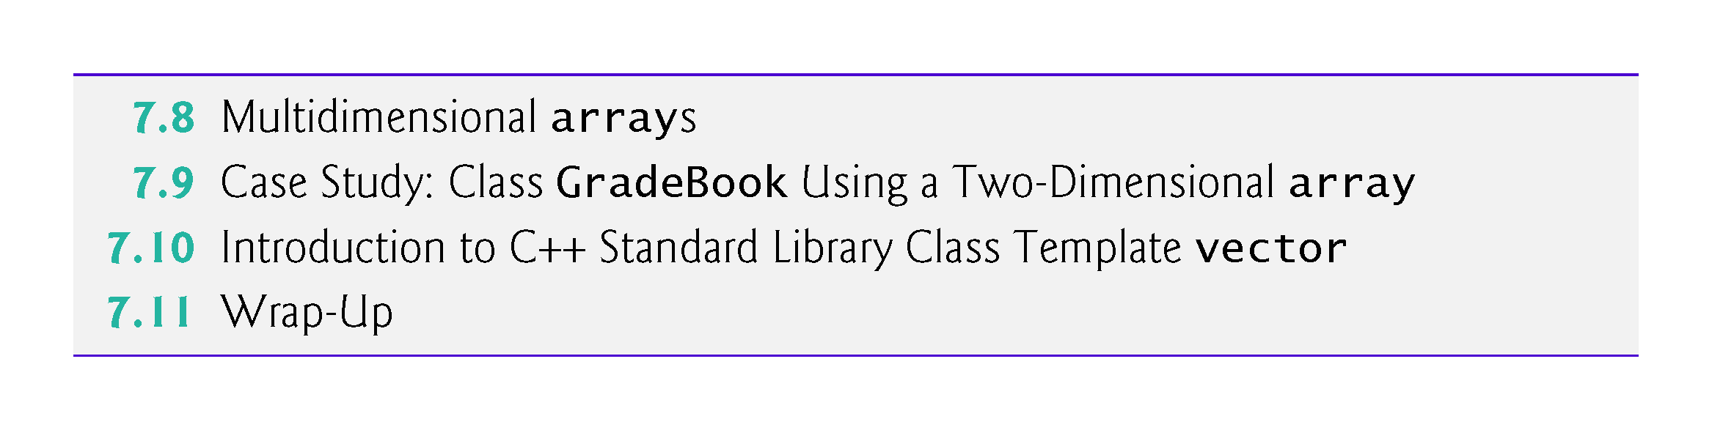

Slide 5
7.5 Range-Based for Statement
It’s common to process all the elements of an array.
The C++11 range-based for statement allows you to do this without using a counter, thus avoiding the possibility of “stepping outside” the array and eliminating the need for you to implement your own bounds checking.
Figure 7.11 uses the range-based for to display an array’s contents and to multiply each of the array’s element values by 2.

Slide 6
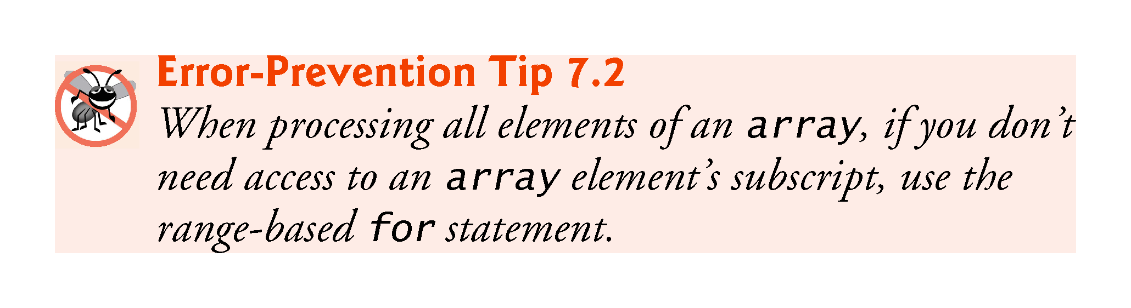

Slide 7
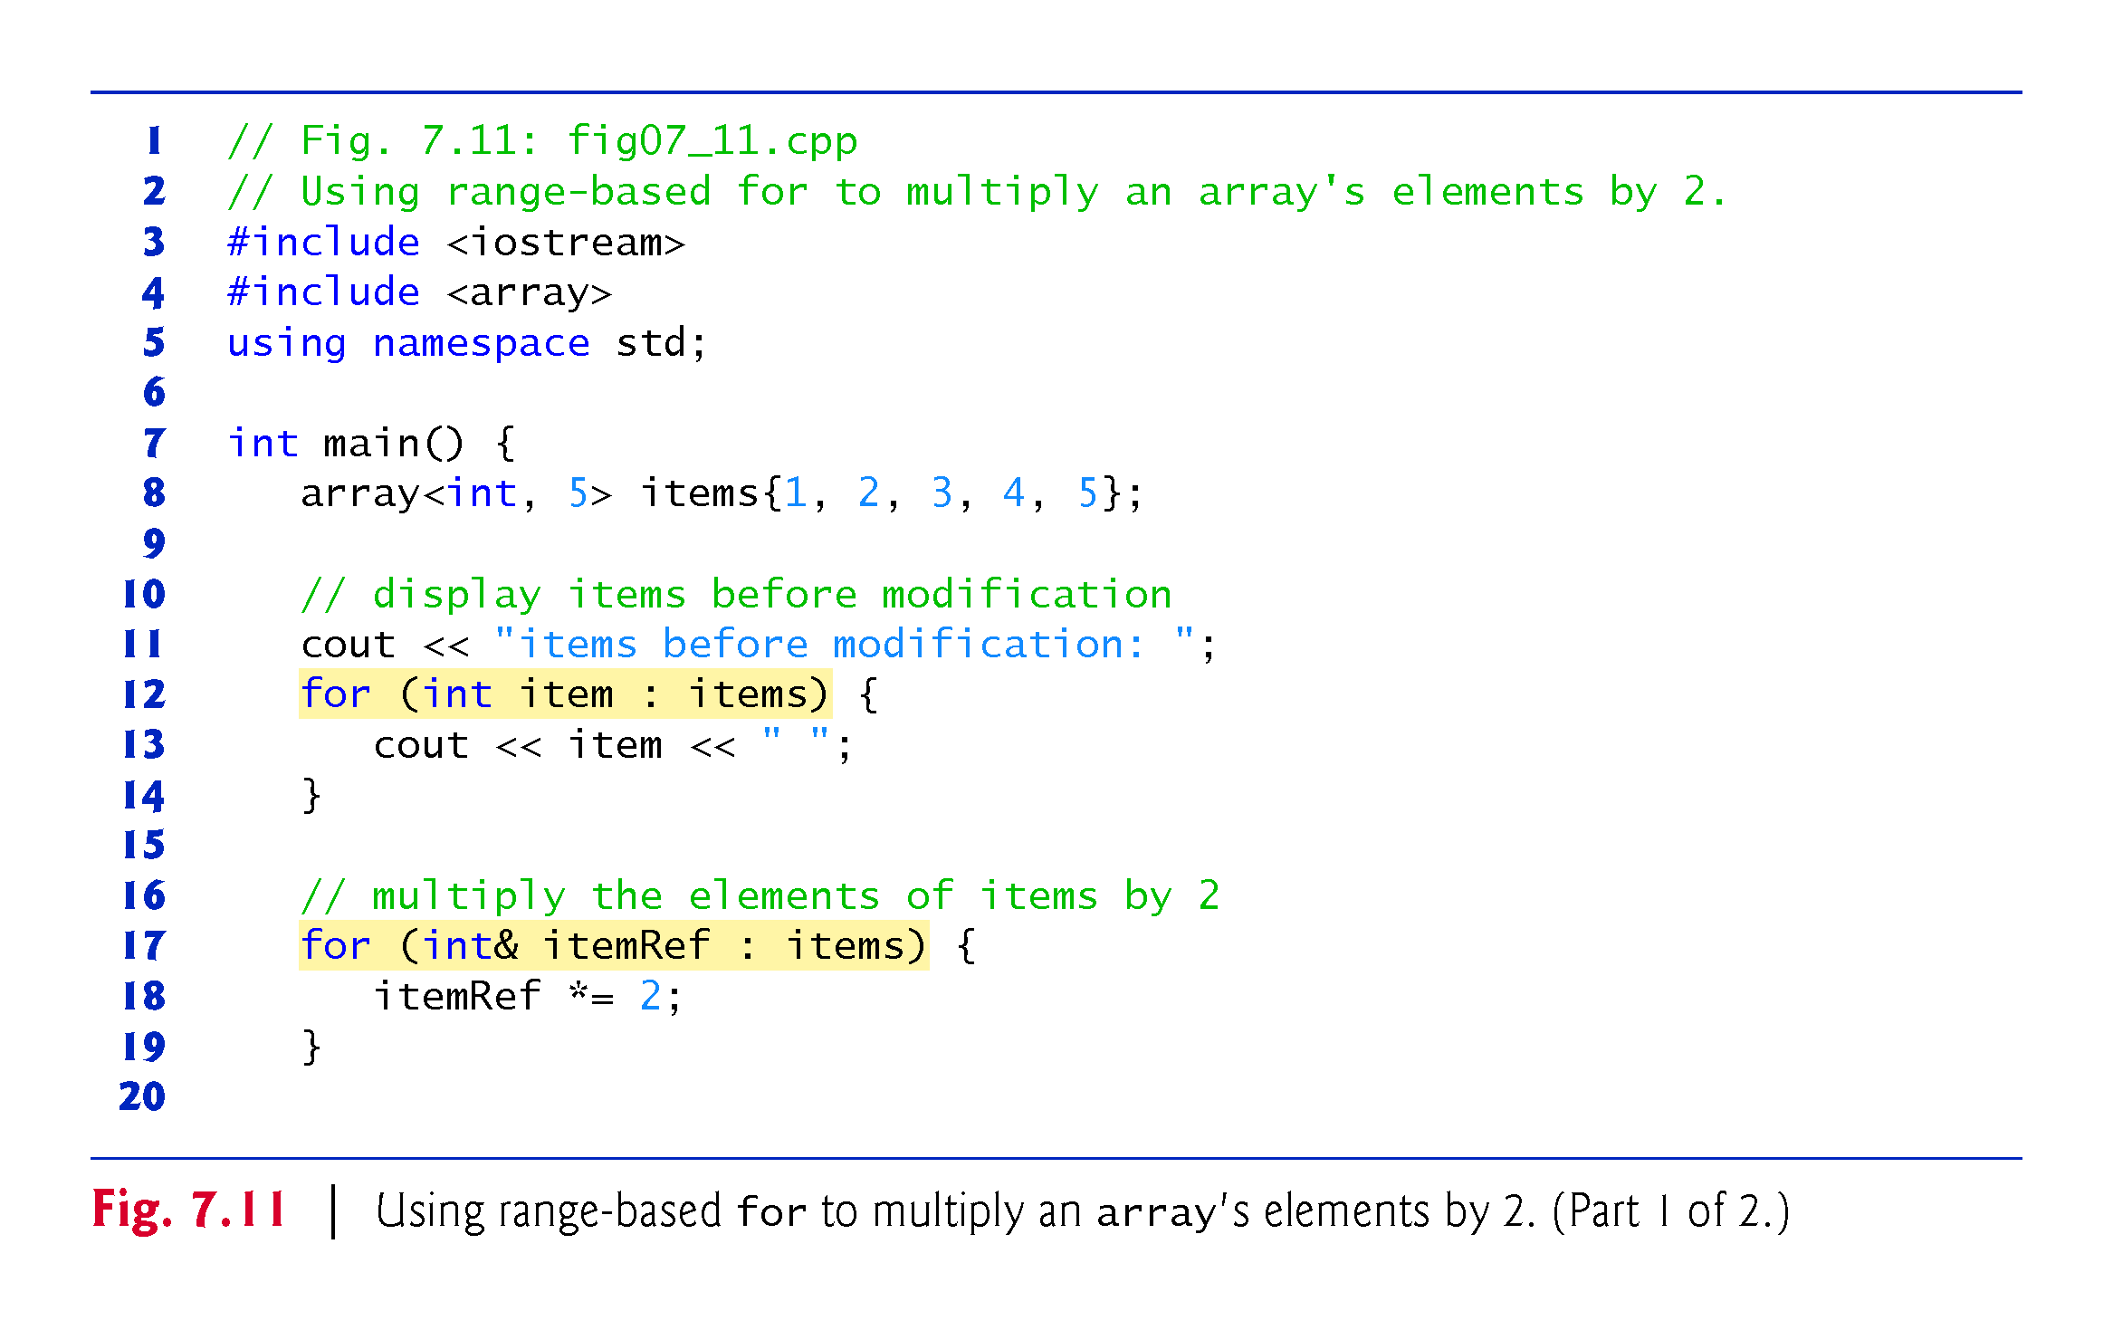

Slide 8
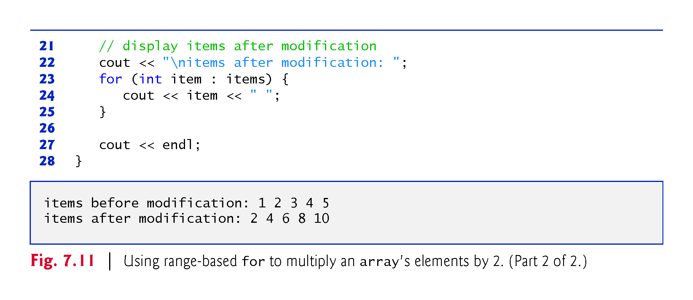

Slide 9
7.5 Range-Based for Statement (cont.)
Using the Range-Based for to Display an array’s Contents
The range-based for statement simplifies the code for iterating through an array.
Line 12 can be read as “for each iteration, assign the next element of items to int variable item, then execute the following statement.”
Lines 12–14 are equivalent to the following counter-controlled iteration:
for (int counter = 0; counter < items.size(); ++counter) {
cout << items[counter] << " "; }

Slide 10
7.5 Range-Based for Statement (cont.)
Using the Range-Based for to Modify an array’s Contents
Lines 17–19 use a range-based for statement to multiply each element of items by 2.
In line 17, the range variable declaration indicates that itemRef is an int reference (&).
We use an int reference because items contains int values and we want to modify each element’s value—because itemRef is declared as a reference, any change you make to itemRef changes the corresponding element value in the array.

Slide 11
7.5 Range-Based for Statement (cont.)
Using an Element’s Subscript
The range-based for statement can be used in place of the counter-controlled for statement whenever code looping through an array does not require access to the element’s subscript.
However, if a program must use subscripts for some reason other than simply to loop through an array (e.g., to print a subscript number next to each array element value, as in the examples early in this chapter), you should use the counter-controlled for statement.

Slide 12
7.6 Case Study: Class GradeBook Using an array to Store Grades
Case study on developing a GradeBook class that instructors can use to maintain students’ grades on an exam and display a grade report that includes the grades, class average, lowest grade, highest grade and a grade distribution bar chart.
This version stores the grades for one exam in a one-dimensional array.
In Section 7.9, we present a version that uses a two-dimensional array to store students’ grades for several exams.

Slide 13
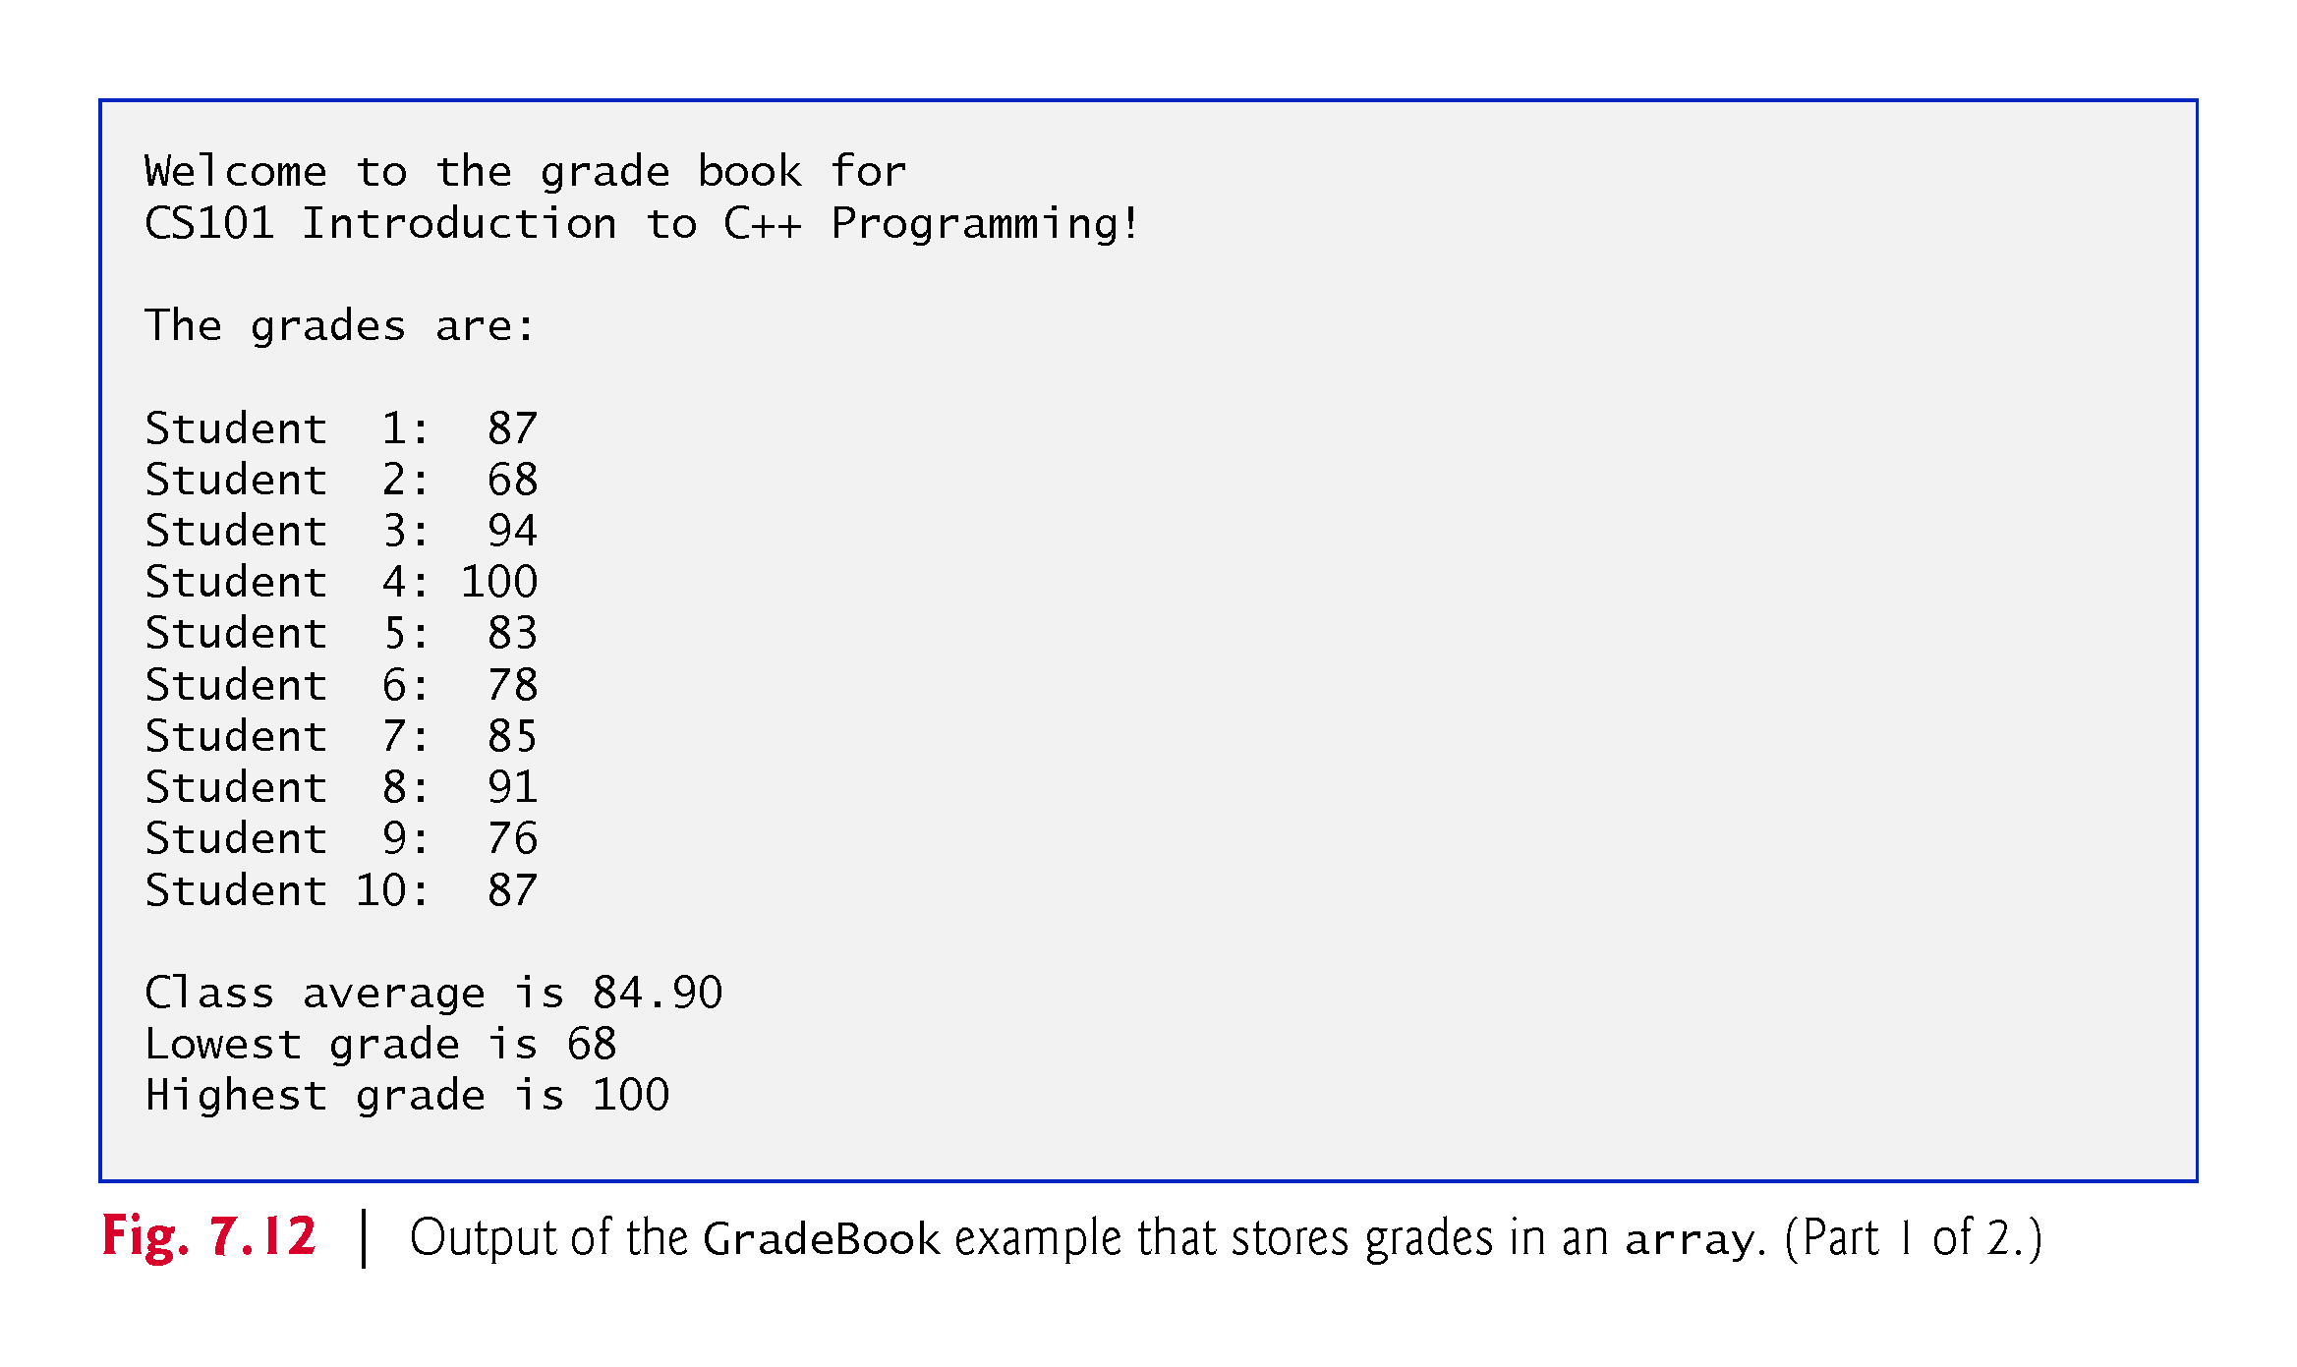

Slide 14
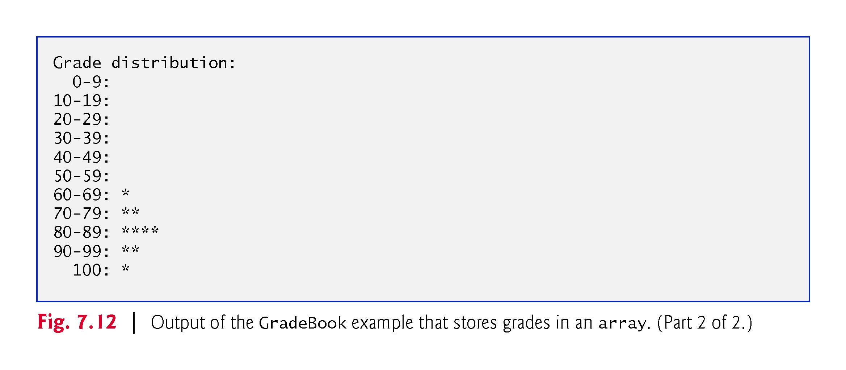

Slide 15
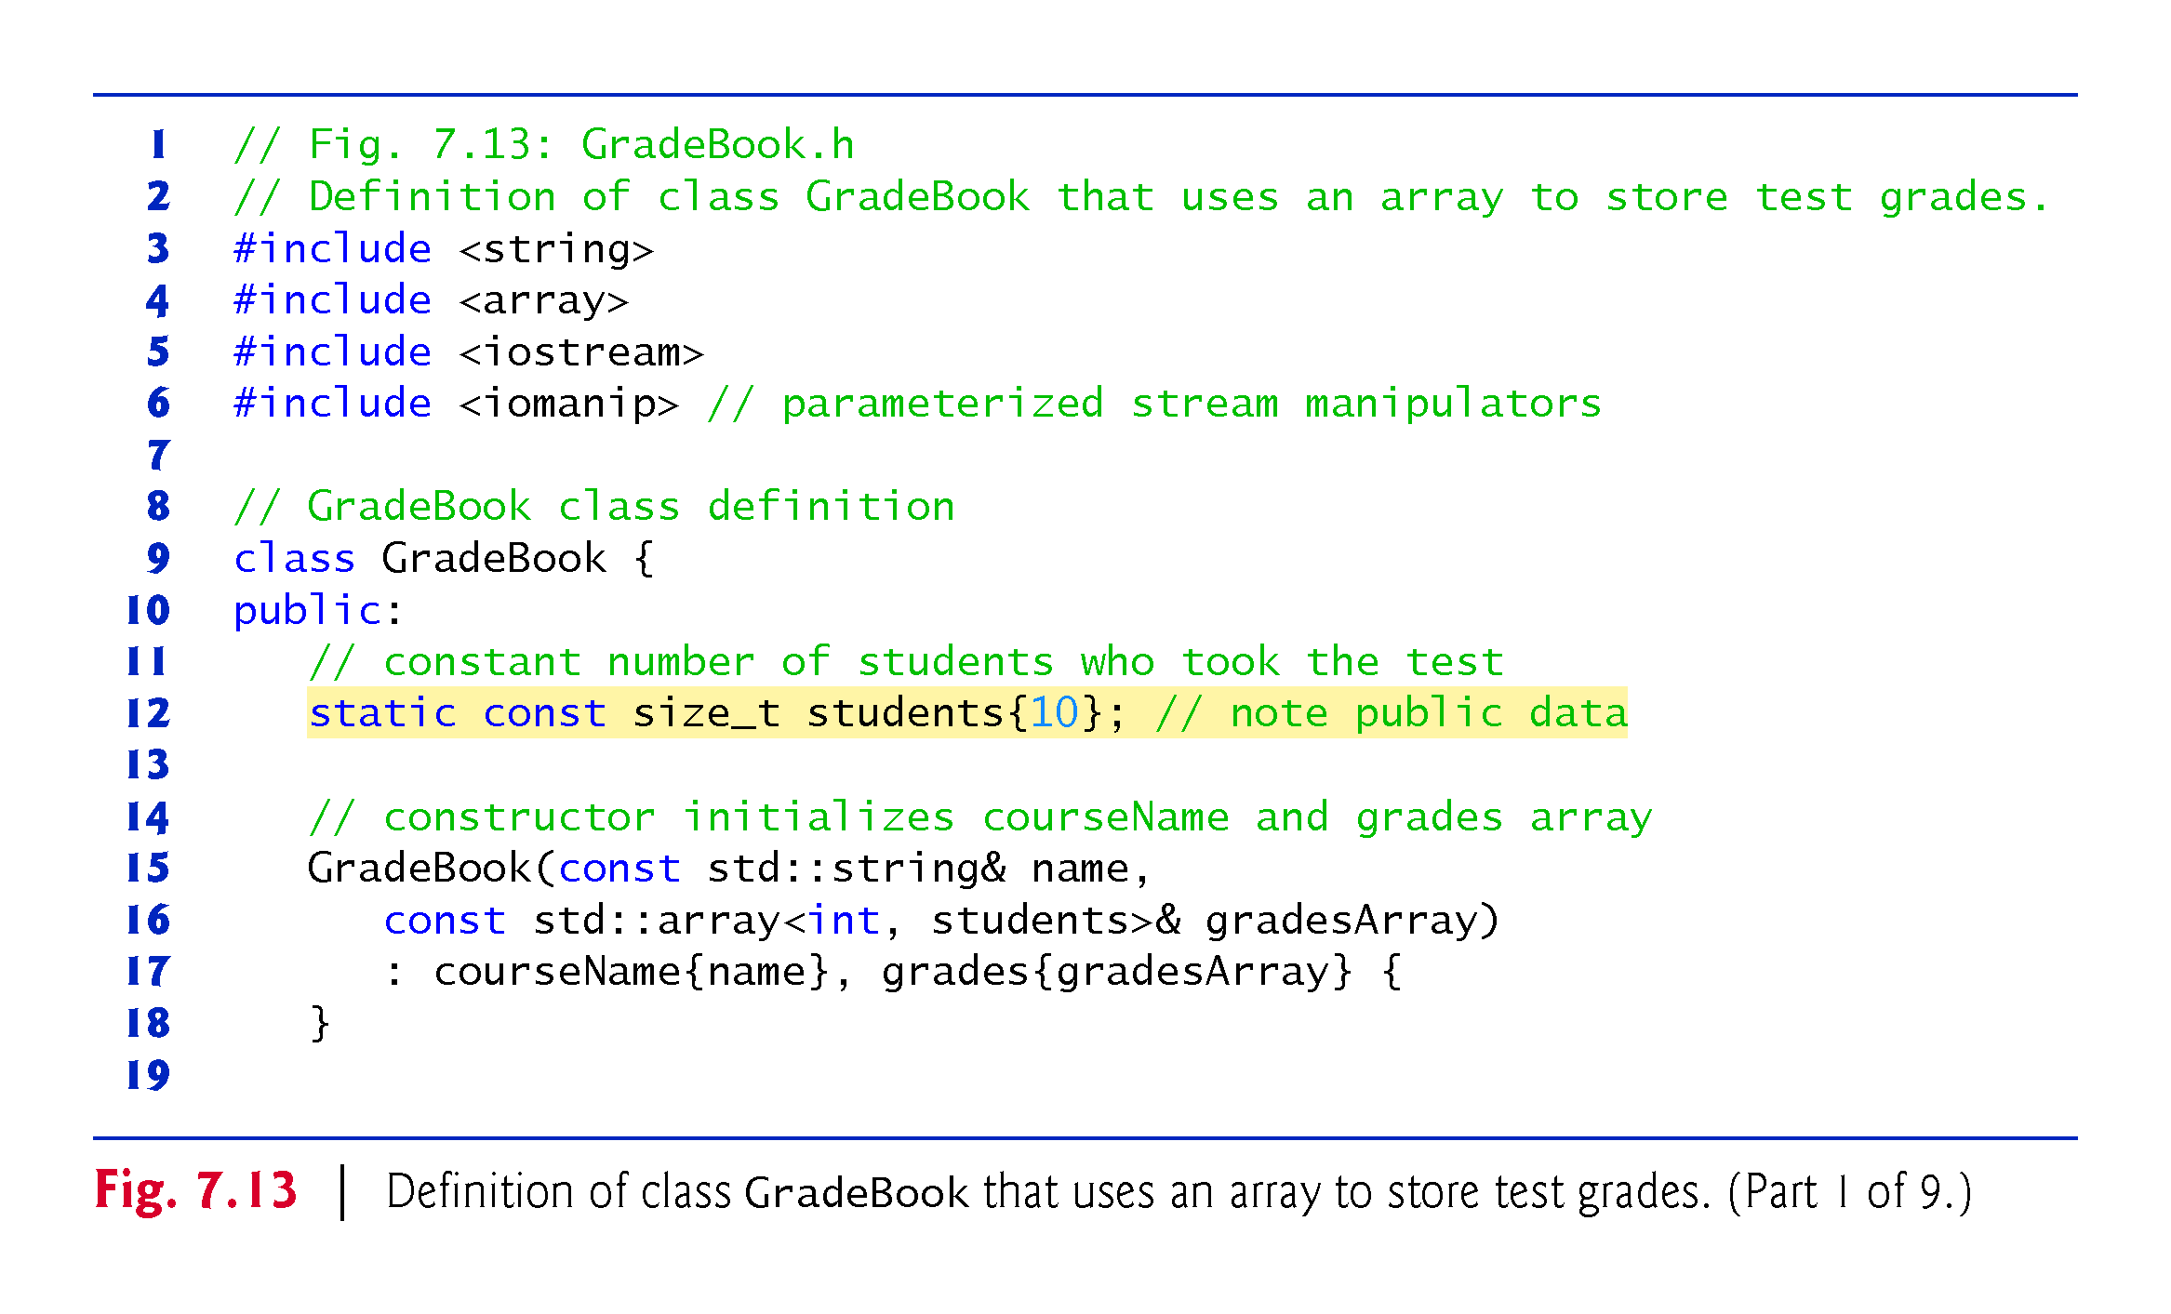

Slide 16
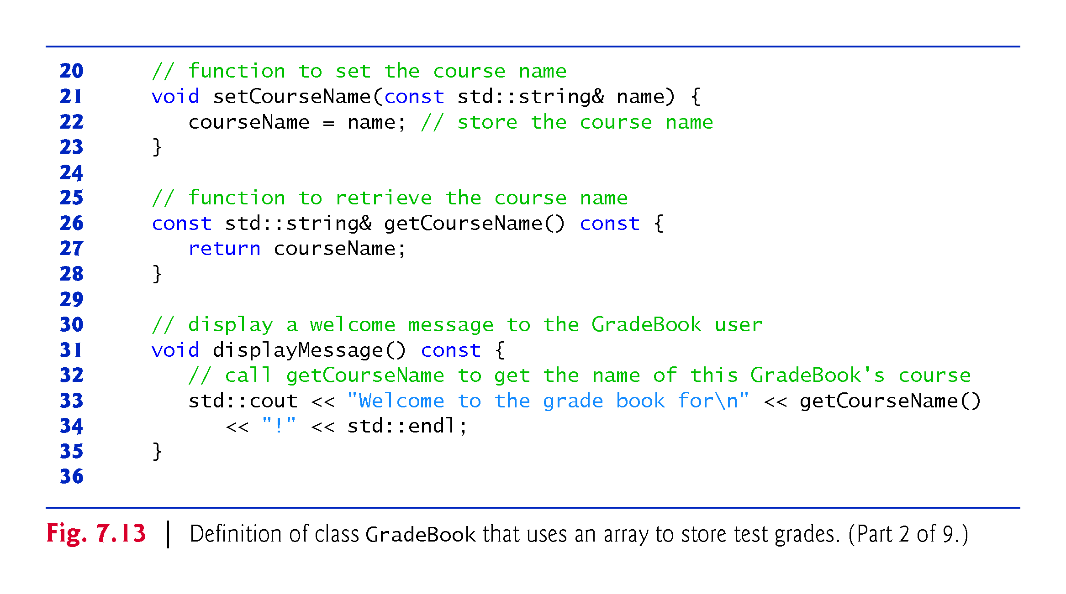

Slide 17
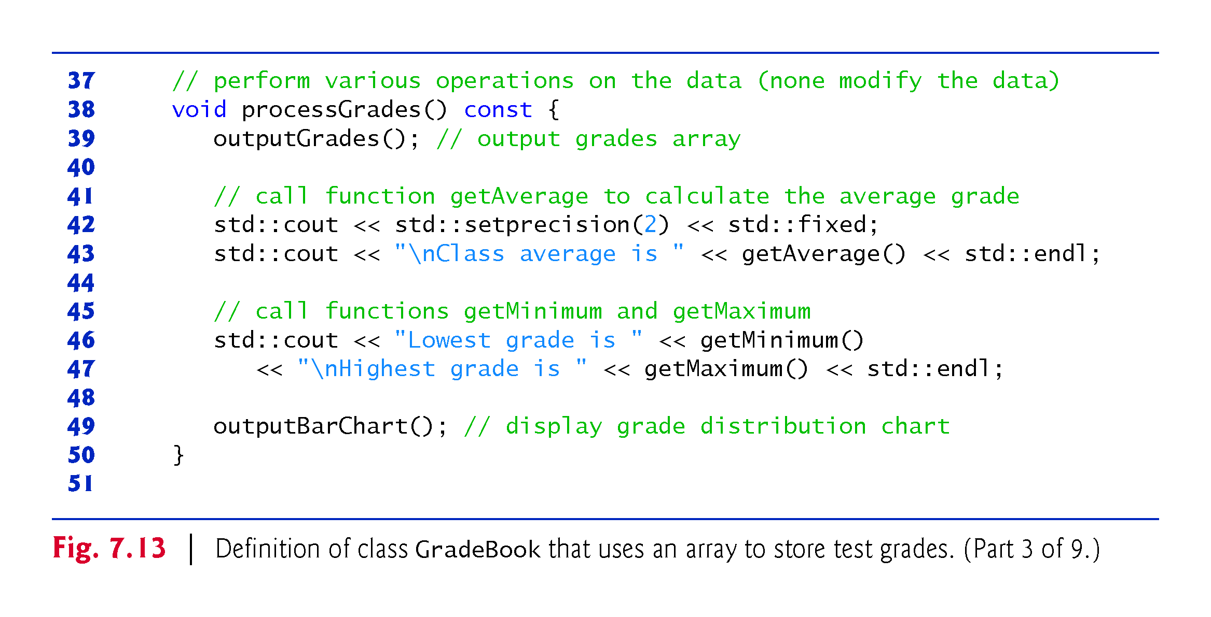

Slide 18
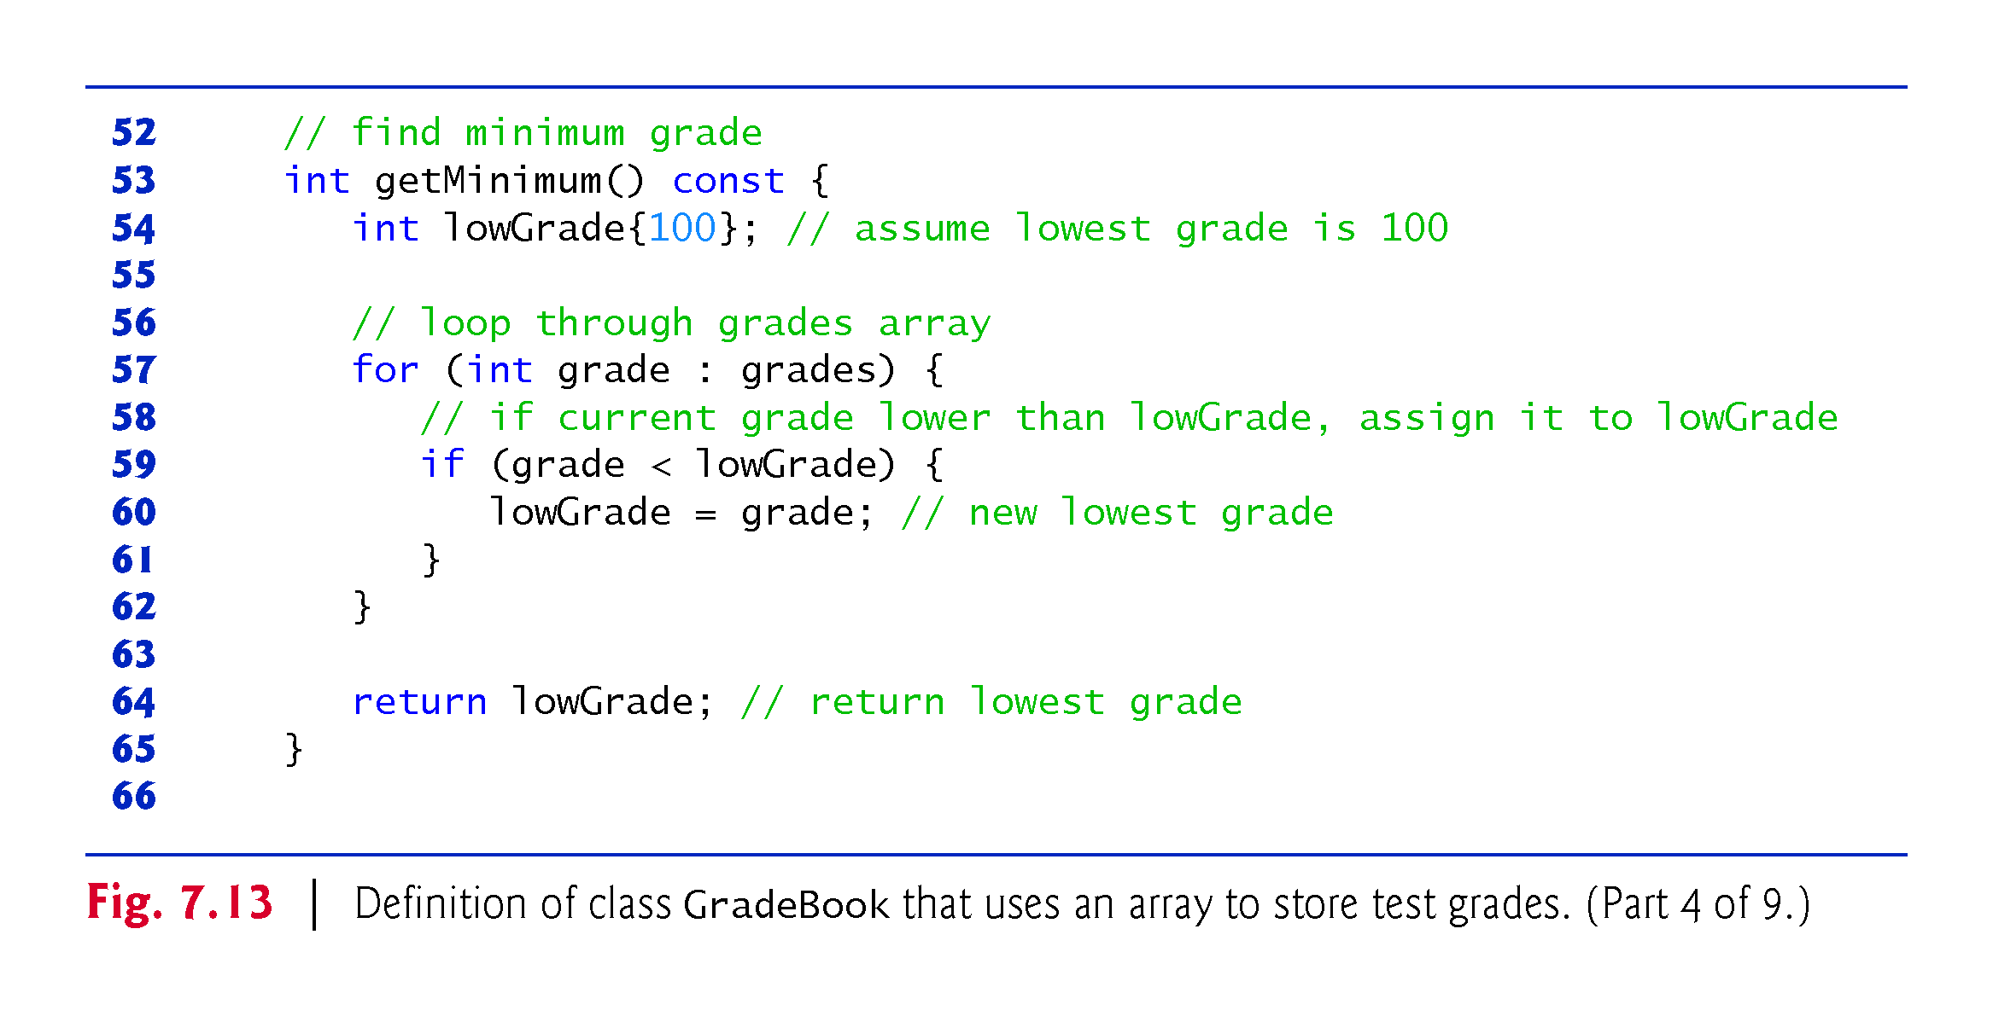

Slide 19
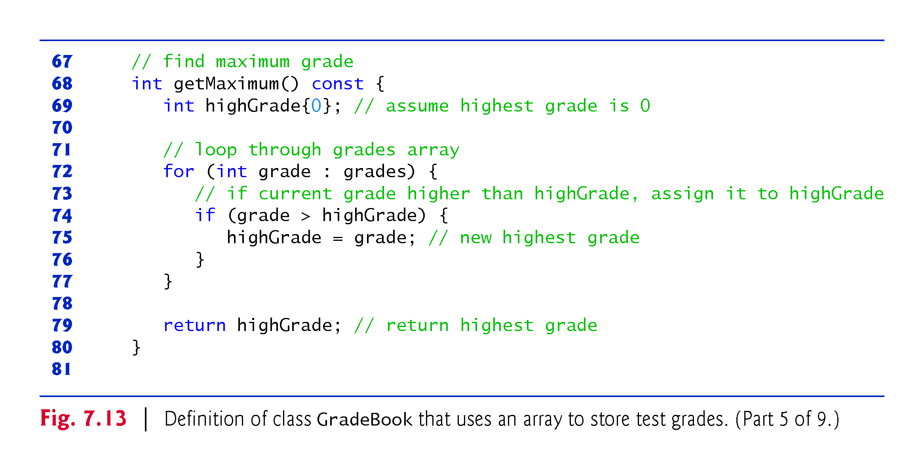

Slide 20
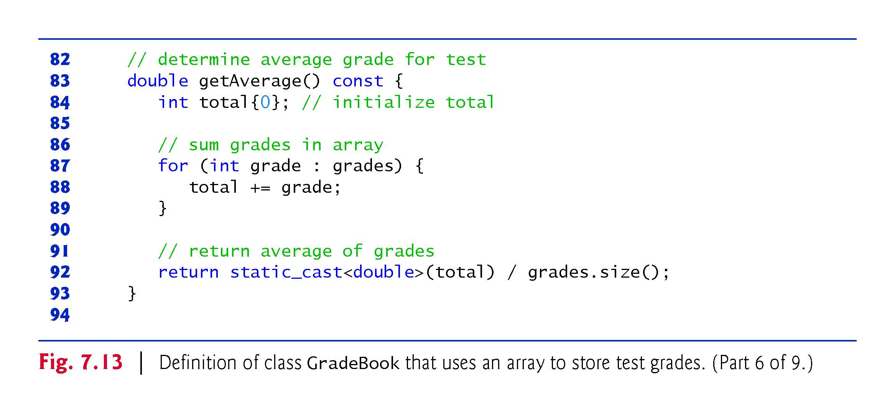

Slide 21
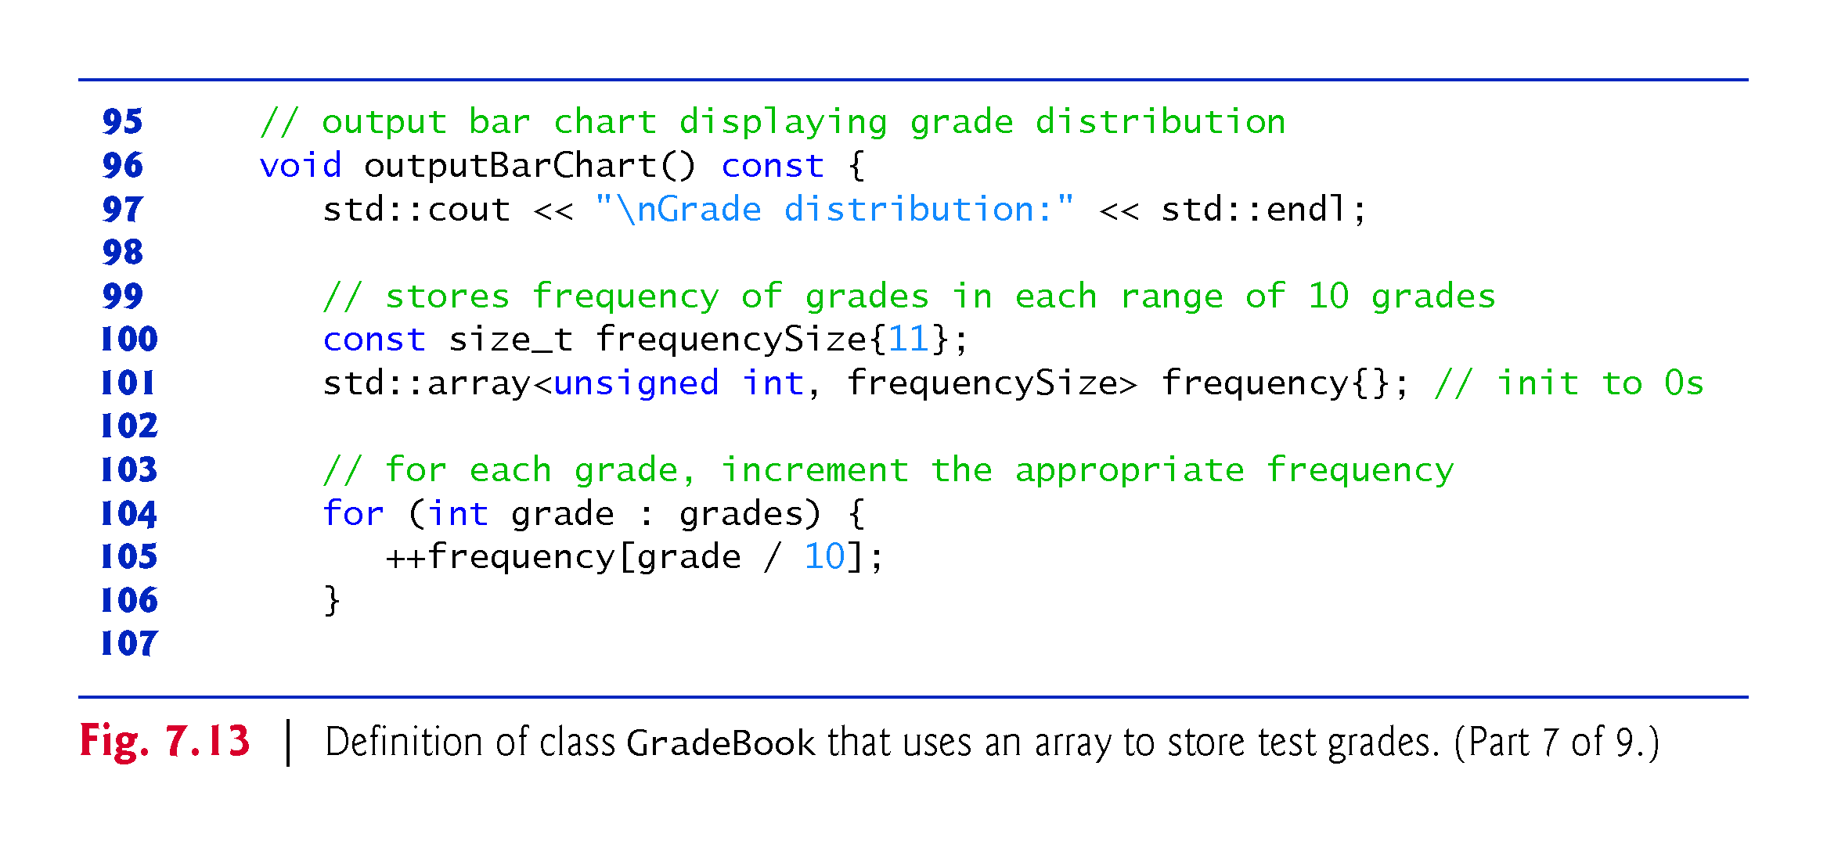

Slide 22
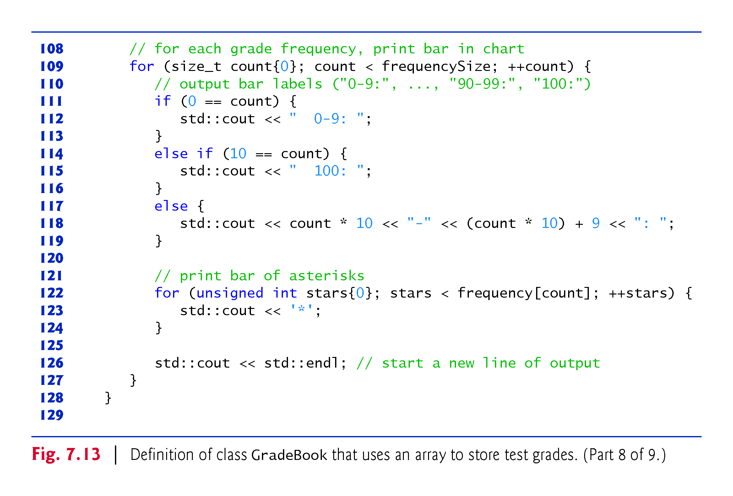

Slide 23
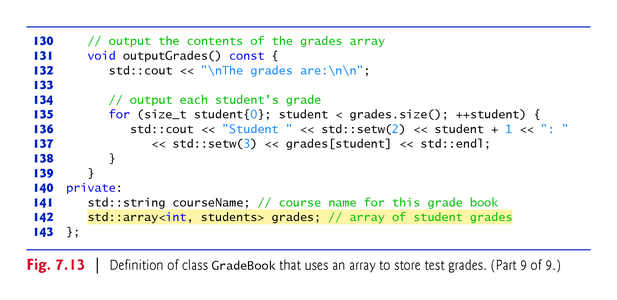

Slide 24
7.6 Case Study: Class GradeBook Using an Array to Store Grades (cont.)
The size of the array is specified as a public static const data member students.
public so that it’s accessible to the clients of the class.
const so that this data member is constant.
static so that the data member is shared by all objects of the class
There are variables for which each object of a class does not have a separate copy.
That’s the case with static data members, which are also known as class variables.
When objects of a class containing static data members are created, all the objects share one copy of the class’s static data members.

Slide 25
7.6 Case Study: Class GradeBook Using an Array to Store Grades (cont.)
A static data member can be accessed within the class definition and the member-function definitions like any other data member.
A public static data member can also be accessed outside of the class, even when no objects of the class exist, using the class name followed by the binary scope resolution operator (::) and the name of the data member.

Slide 26
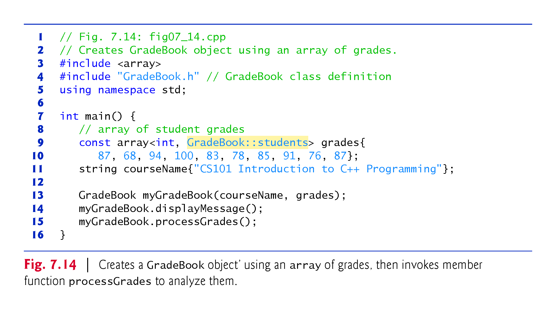

Slide 27
7.7 Sorting and Searching arrays
In this section, we use the built-in C++ Standard Library sort function to arrange the elements in an array into ascending order and the built-in binary_search function to determine whether a value is in the array.

Slide 28
7.7.1 Sorting
Sorting data—placing it into ascending or descending order—is one of the most important computing applications.

Slide 29
7.7.2 Searching
Often it may be necessary to determine whether an array contains a value that matches a certain key value.
This is called searching.

Slide 30
7.7.2 Searching
Figure 7.15 begins by creating an unsorted array of strings and displaying the contents of the array.
Line 21 uses C++ Standard Library function sort to sort the elements of the array colors into ascending order.
Lines 25–276 display the contents of the sorted array.

Slide 31
7.7 Sorting and Searching arrays (cont.)
Lines 30 and 354 demonstrate use binary_search to determine whether a value is in the array.
The sequence of values must be sorted in ascending order first—binary_search does not verify this for you.
The function’s first two arguments represent the range of elements to search and the third is the search key—the value to locate in the array.
The function returns a bool indicating whether the value was found.

Slide 32
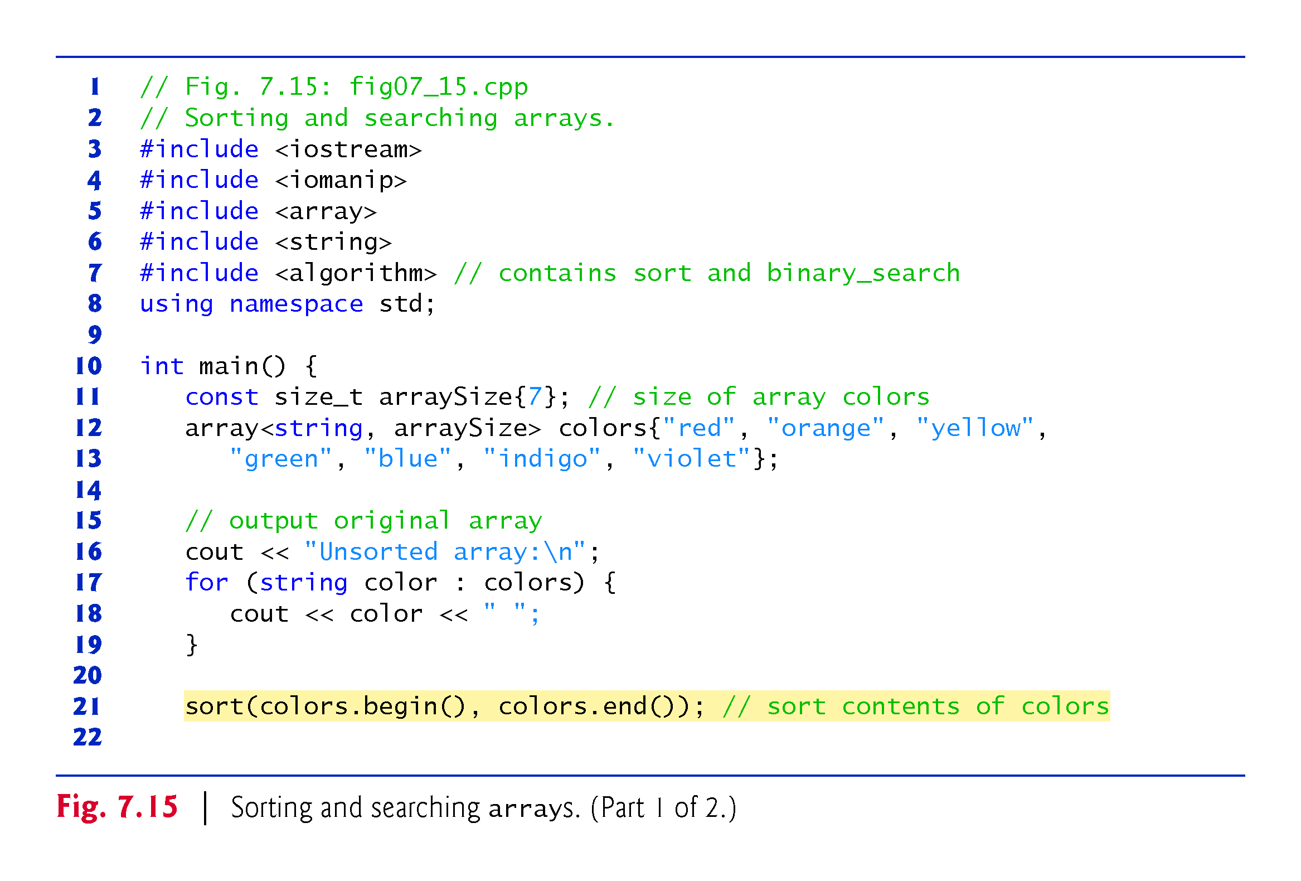

Slide 33
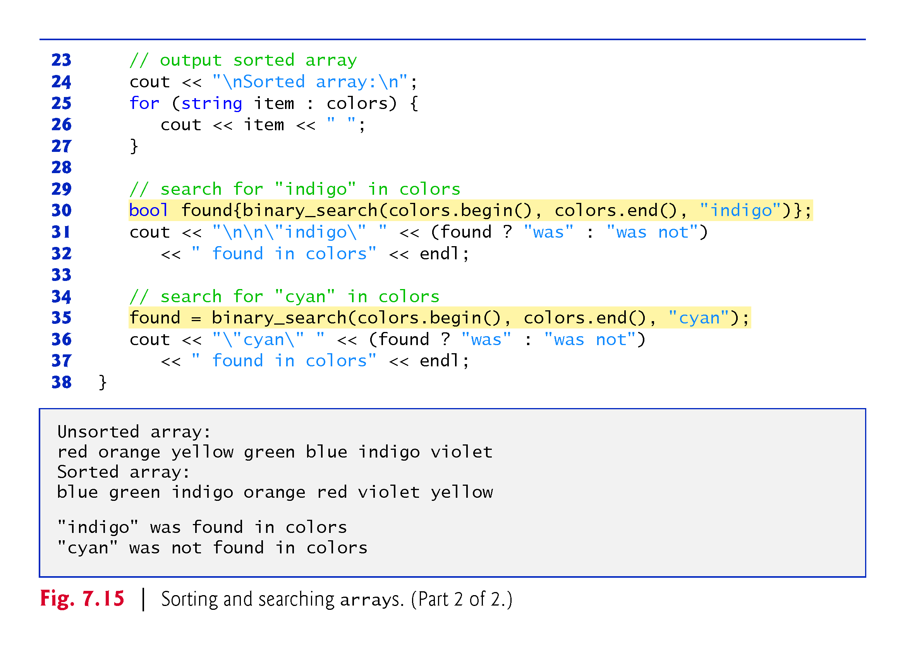

Slide 34
7.8 Multidimensional Arrays
You can use arrays with two dimensions (i.e., subscripts) to represent tables of values consisting of information arranged in rows and columns.
To identify a particular table element, we must specify two subscripts—by convention, the first identifies the element’s row and the second identifies the element’s column.
Often called two-dimensional arrays or 2-D arrays.
Arrays with two or more dimensions are known as multidimensional arrays.
Figure 7.16 illustrates a two-dimensional array, a.
The array contains three rows and four columns, so it’s said to be a 3-by-4 array.
In general, an array with m rows and n columns is called an m-by-n array.

Slide 35
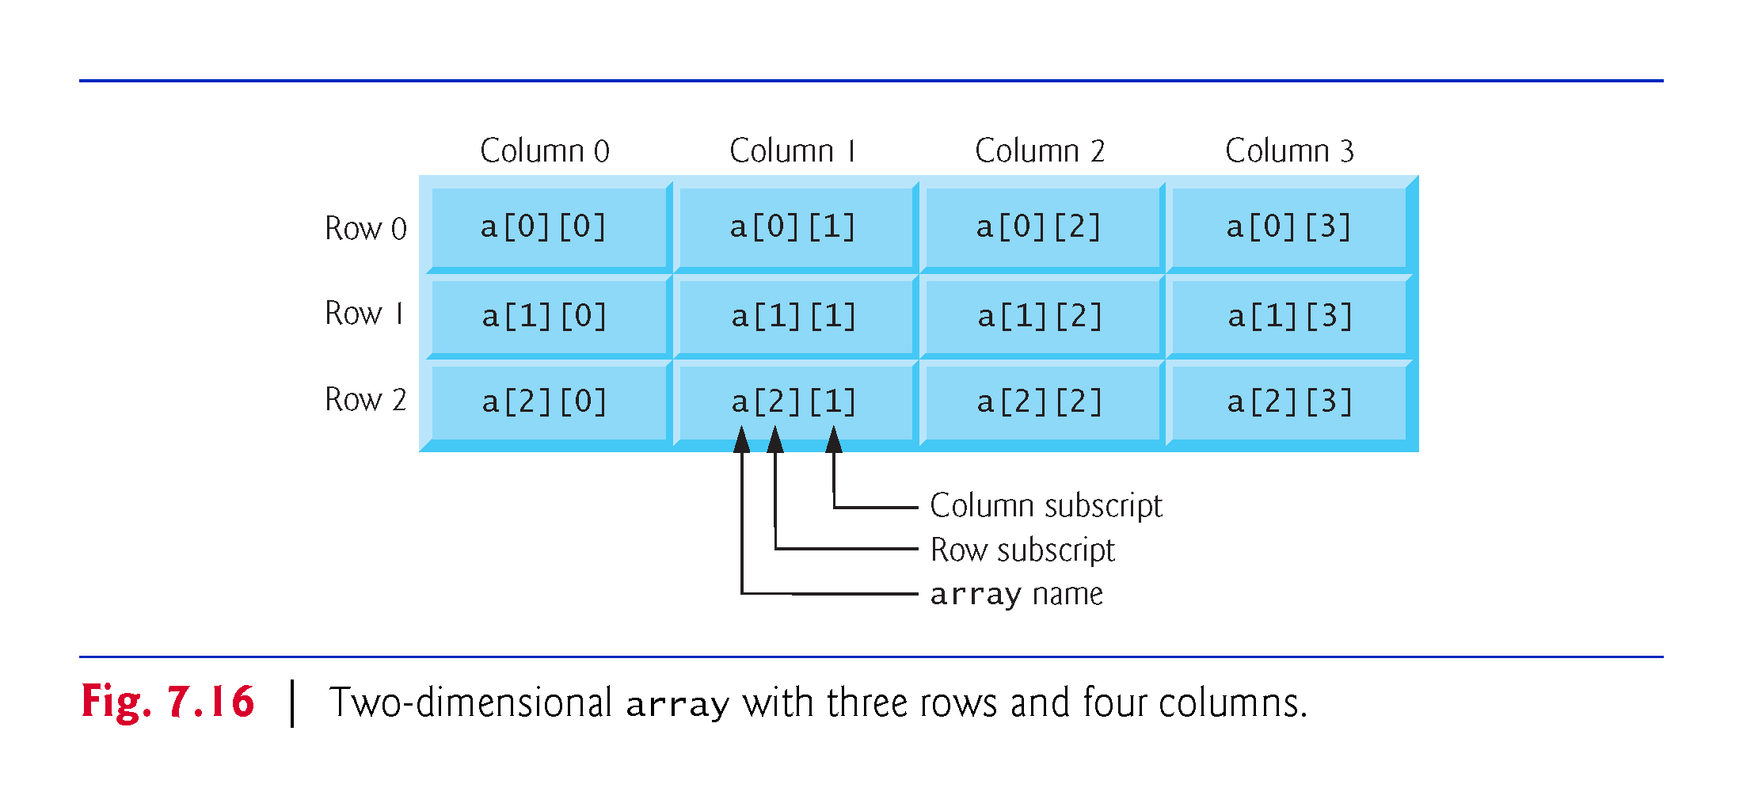

Slide 36
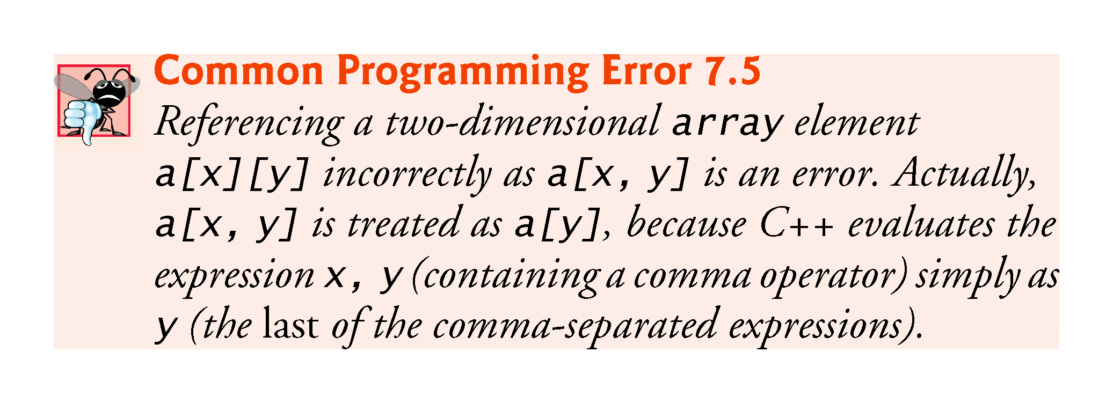

Slide 37
7.8 Multidimensional arrays (cont.)
Figure 7.17 demonstrates initializing two-dimensional arrays in declarations.
In each array, the type of its elements is specified as
array<int, columns>
Each array contains as its elements three-element arrays of int values—the constant columns has the value 3.

Slide 38
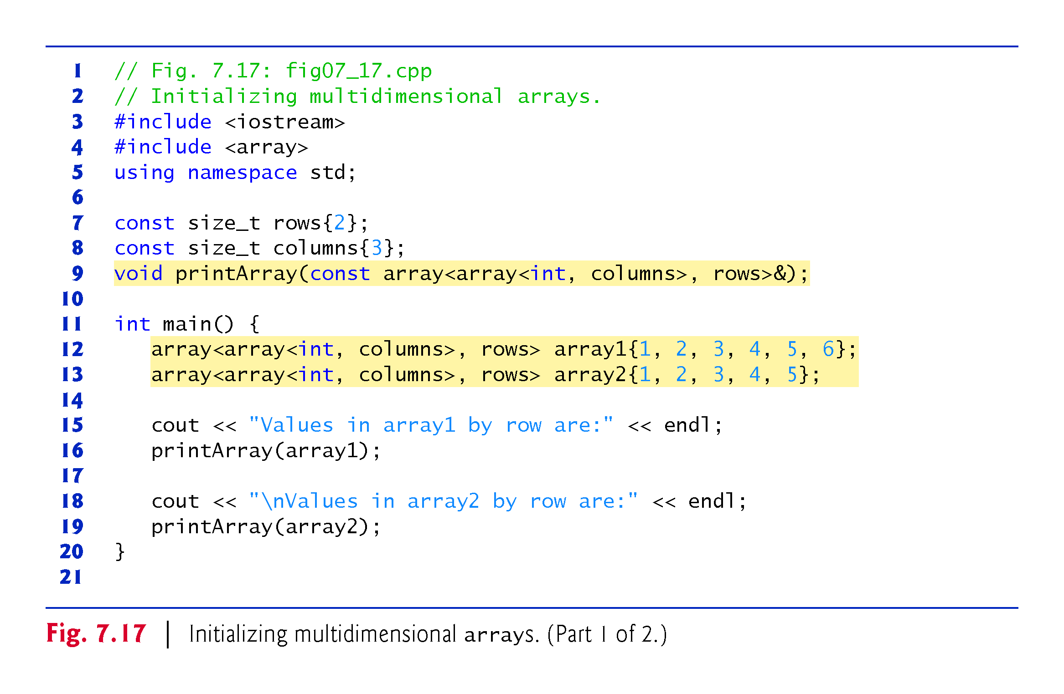

Slide 39
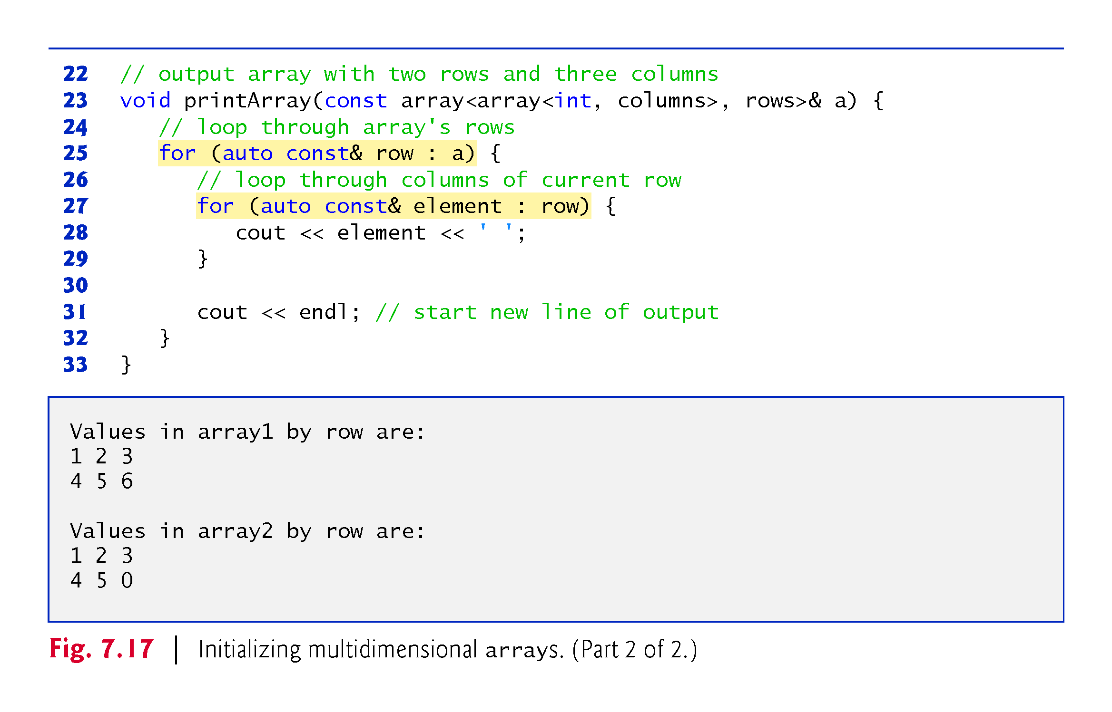

Slide 40
7.8 Multidimensional arrays (cont.)
Nested Range-Based for Statements
To process the elements of a two-dimensional array, we use a nested loop in which the outer loop iterates through the rows and the inner loop iterates through the columns of a given row.
The C++11 auto keyword tells the compiler to infer (determine) a variable’s data type based on the variable’s initializer value.

Slide 41
7.8 Multidimensional arrays (cont.)
Nested Counter-Controlled for Statements
We could have implemented the nested loop with counter-controlled iteration as follows:
for (size_t row = 0; row < a.size(); ++row) {
for (size_t column = 0; column < a[row].size(); ++column) {
cout << a[row][column] << ' '; }
cout << endl;
}

Slide 42
7.9 Case Study: Class GradeBook Using a Two-Dimensional array
In most semesters, students take several exams.
Professors are likely to want to analyze grades across the entire semester, both for a single student and for the class as a whole.
Figure 7.18 shows the output that summarizes 10 students grades on three exams.
We store the grades as a two-dimensional array in an object of the next version of class GradeBook Figures 7.19–7.20.
Each row of the array represents a single student’s grades for the entire course, and each column represents all the grades the students earned for one particular exam.

Slide 43
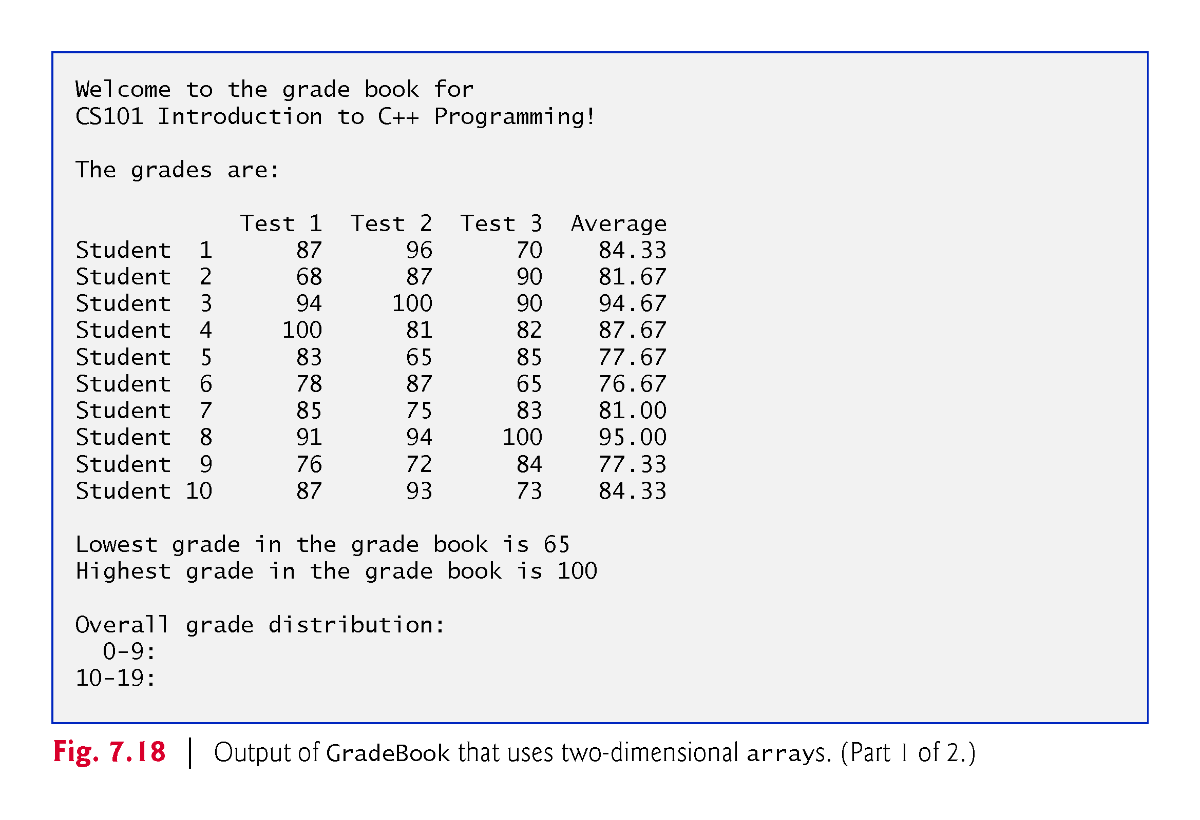

Slide 44
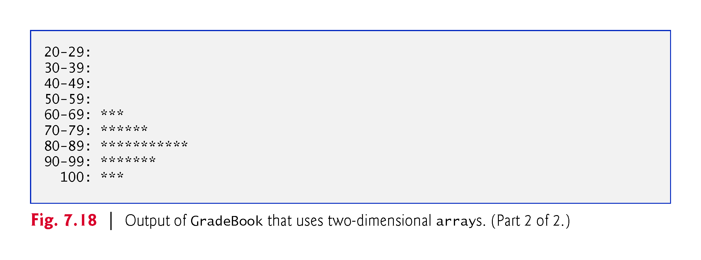

Slide 45
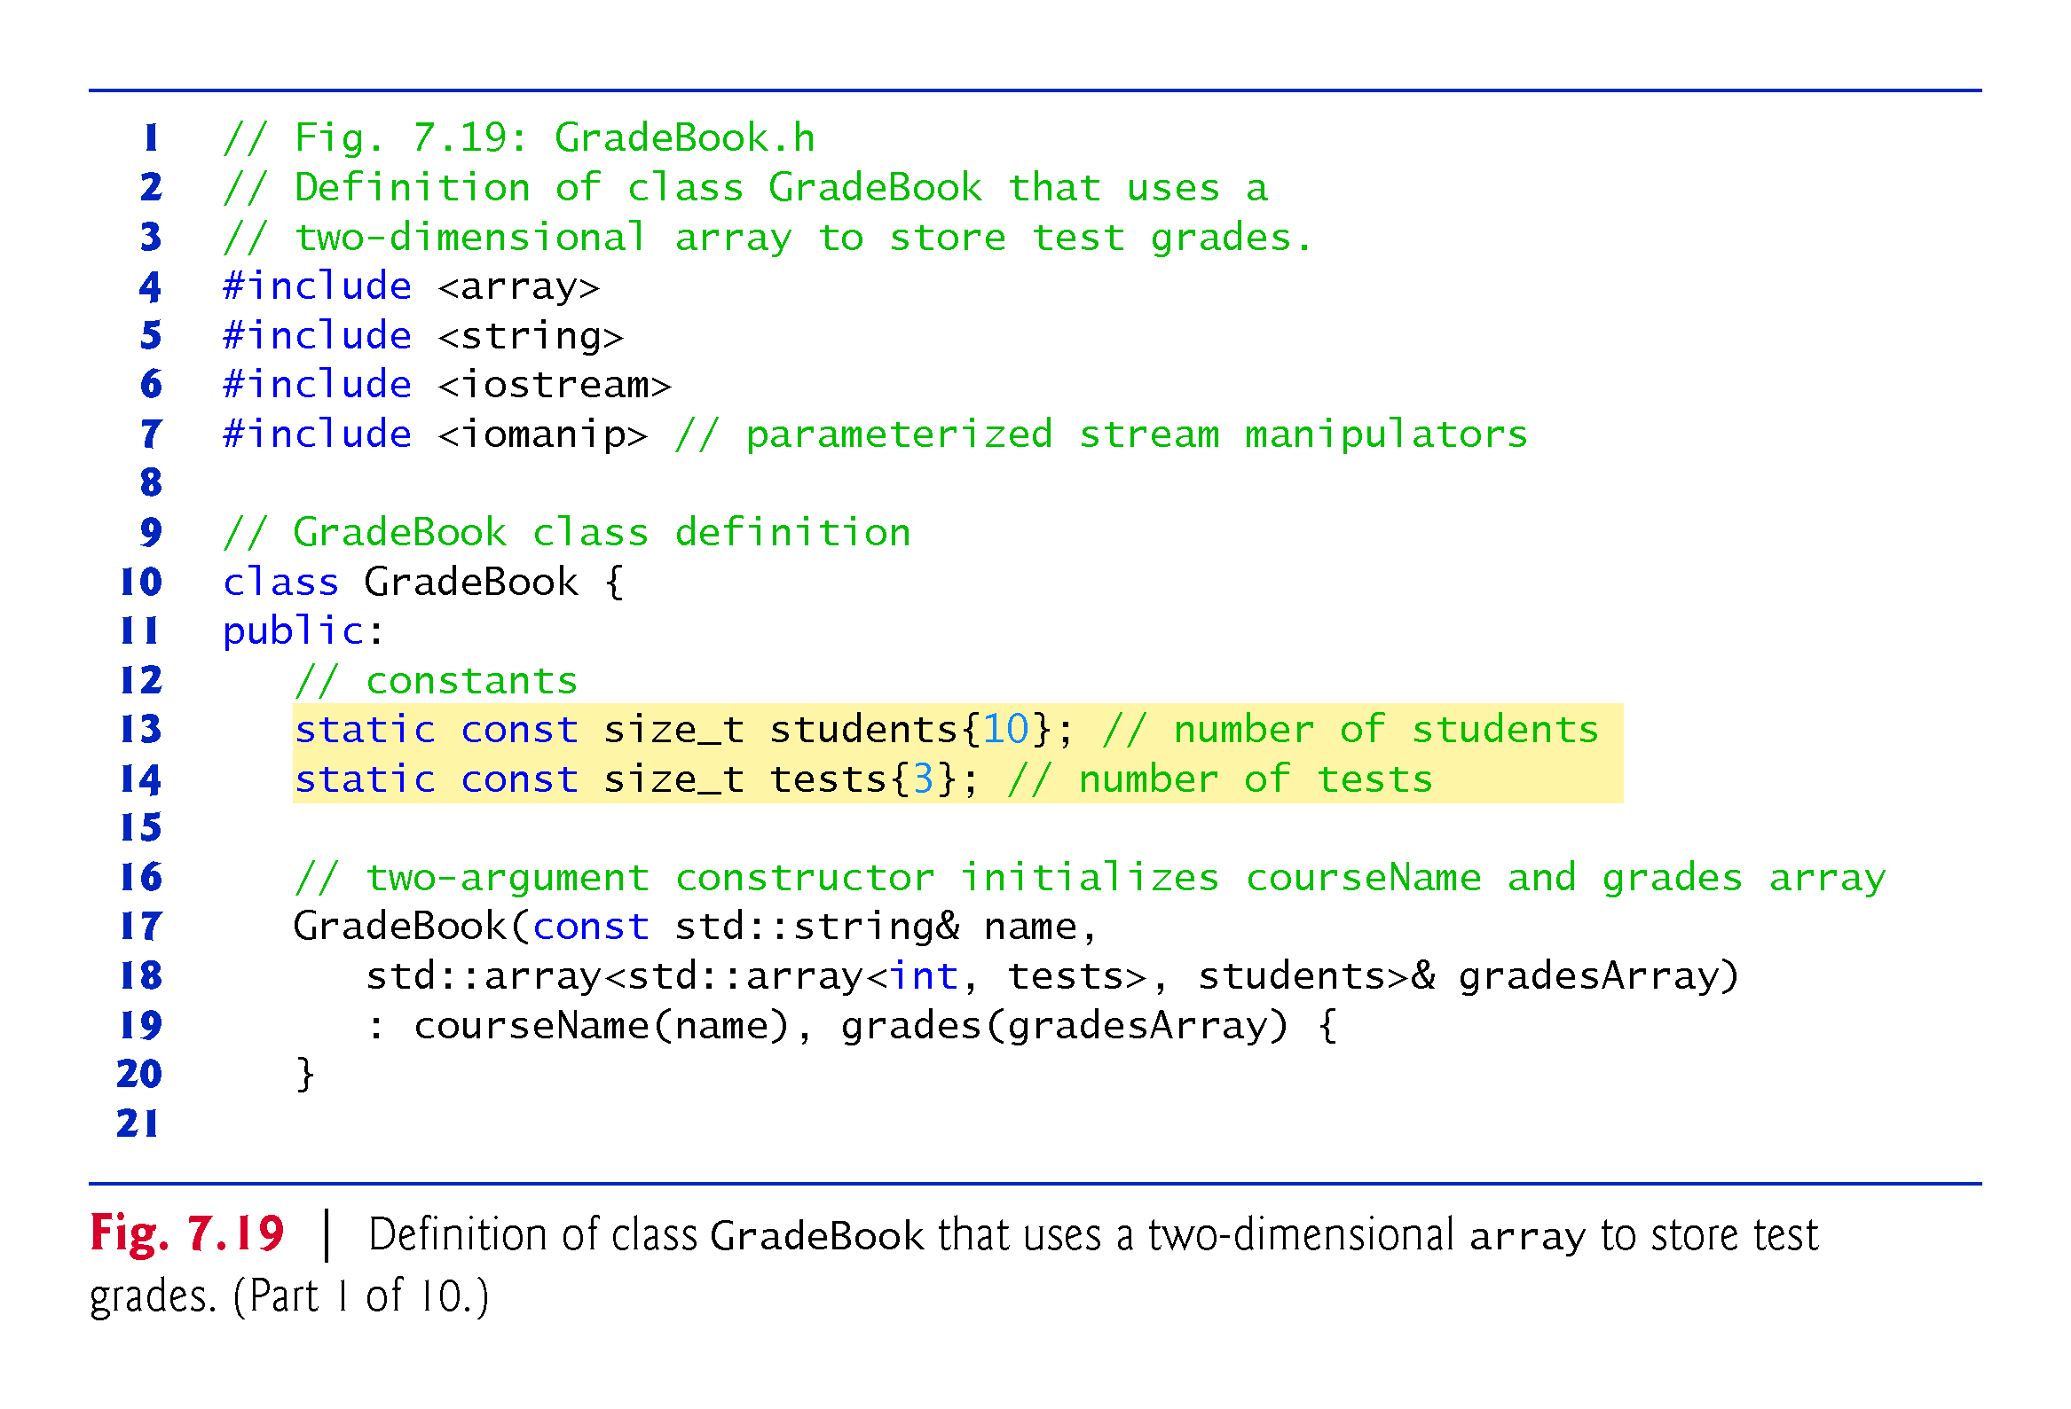

Slide 46
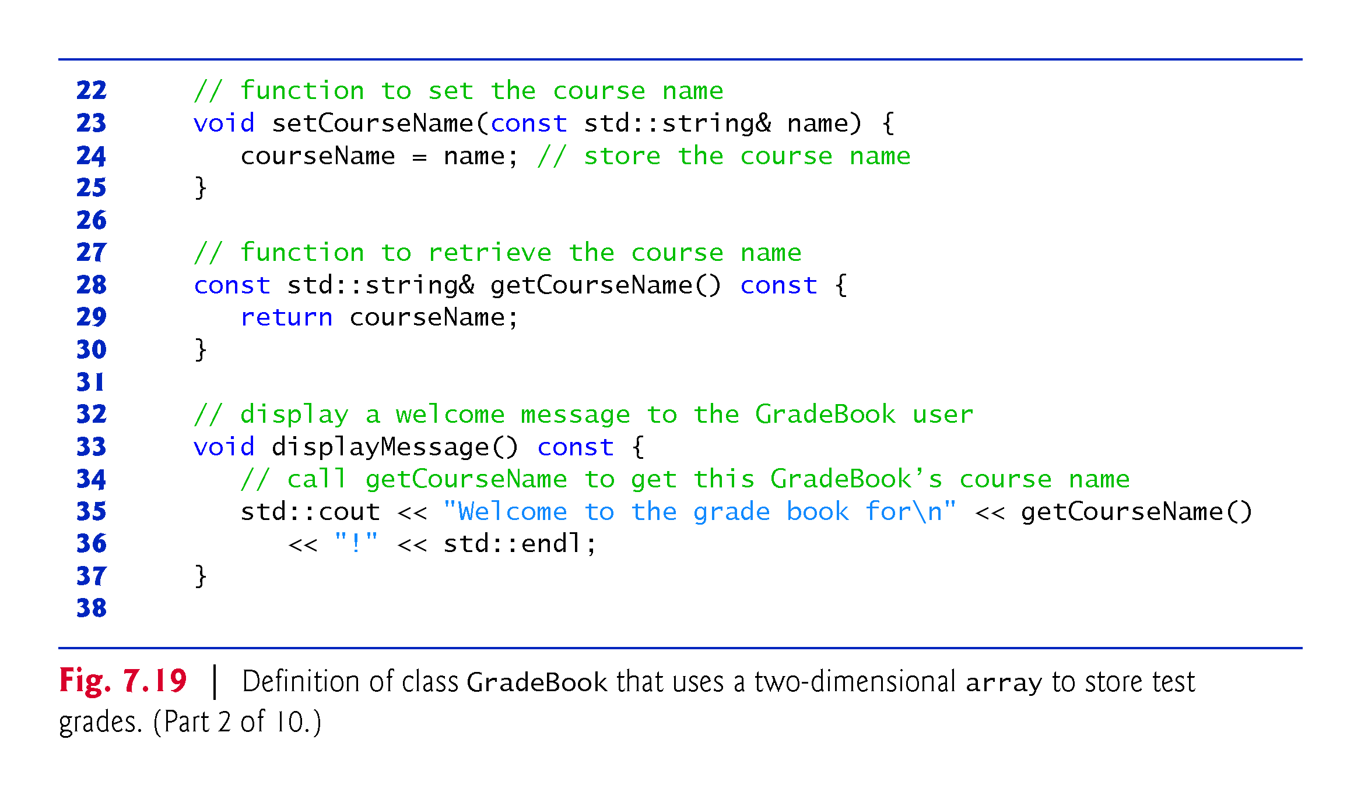

Slide 47
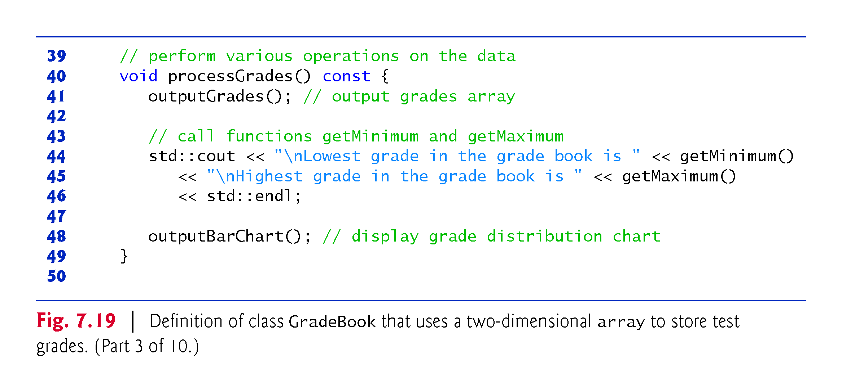

Slide 48
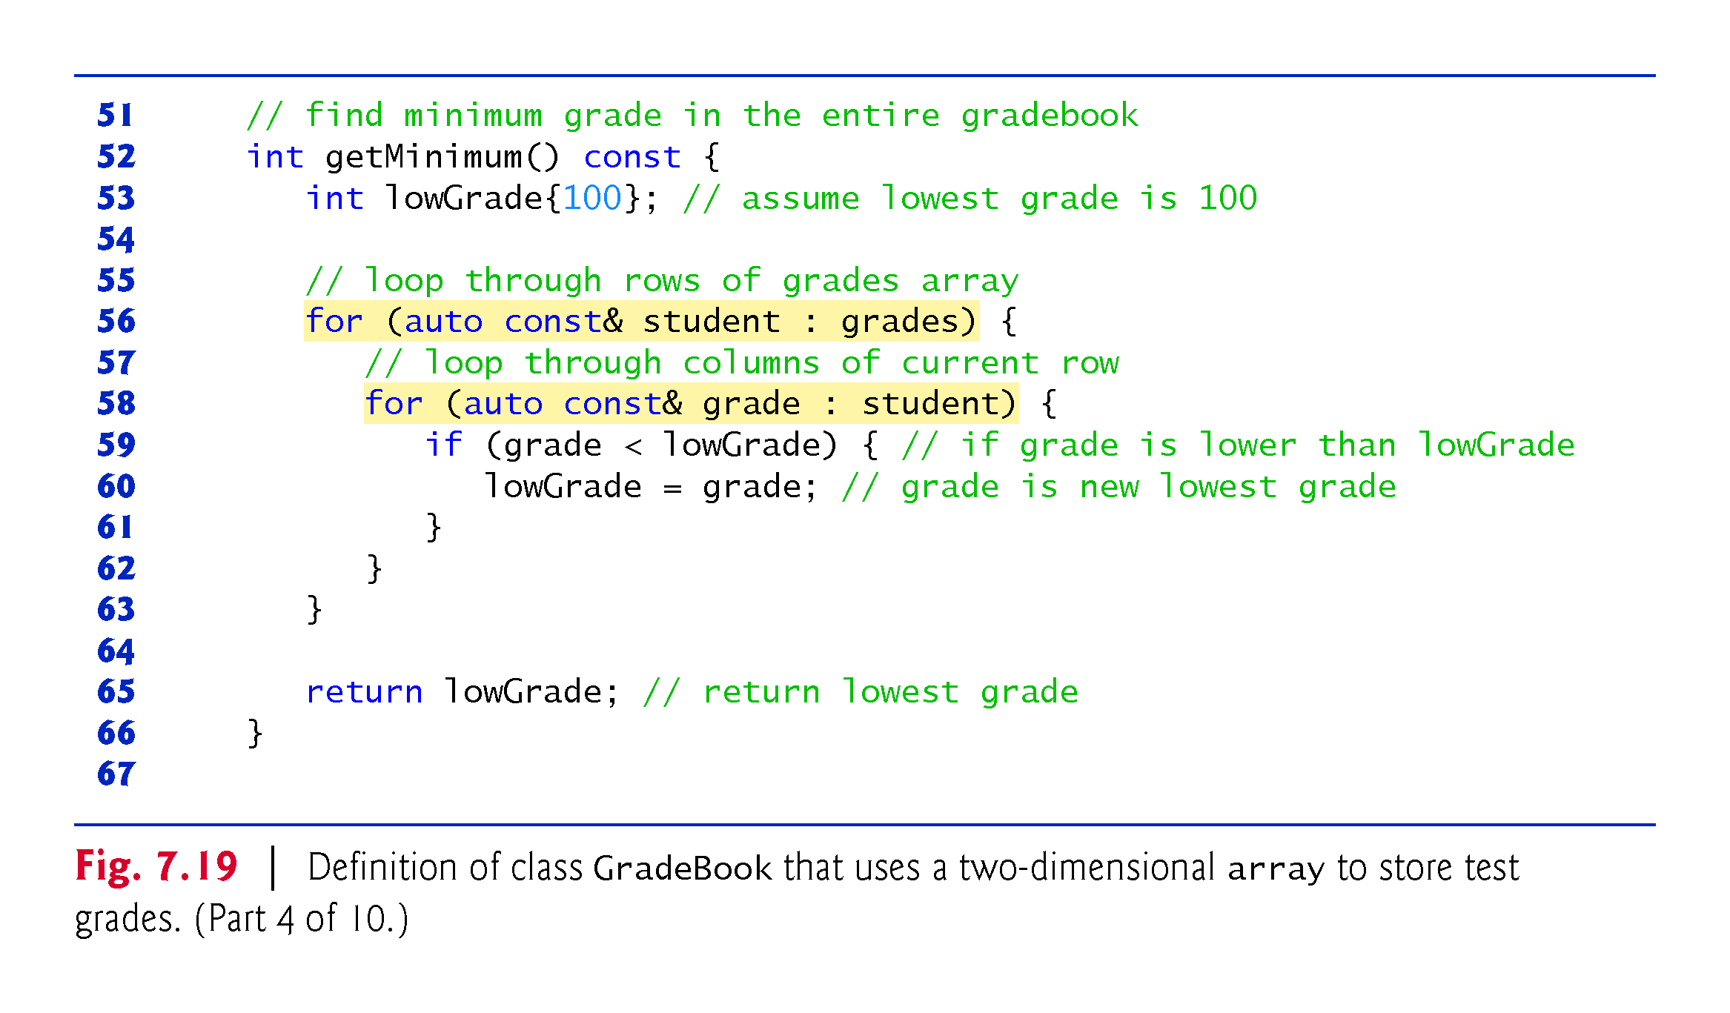

Slide 49
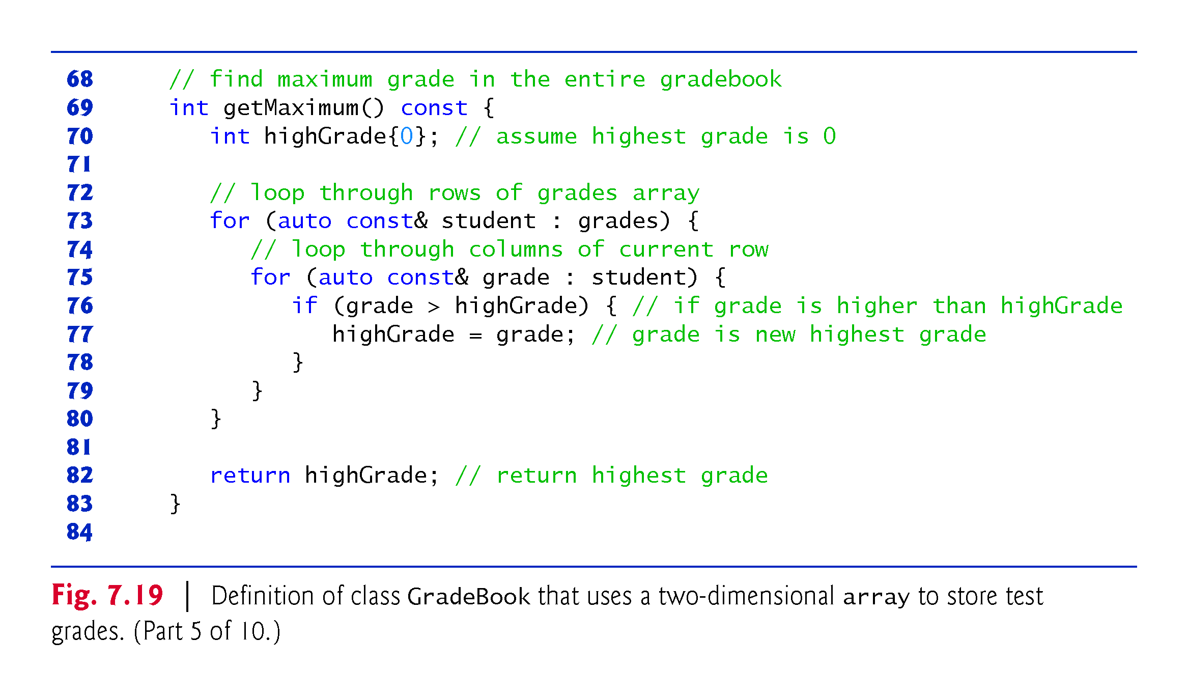

Slide 50
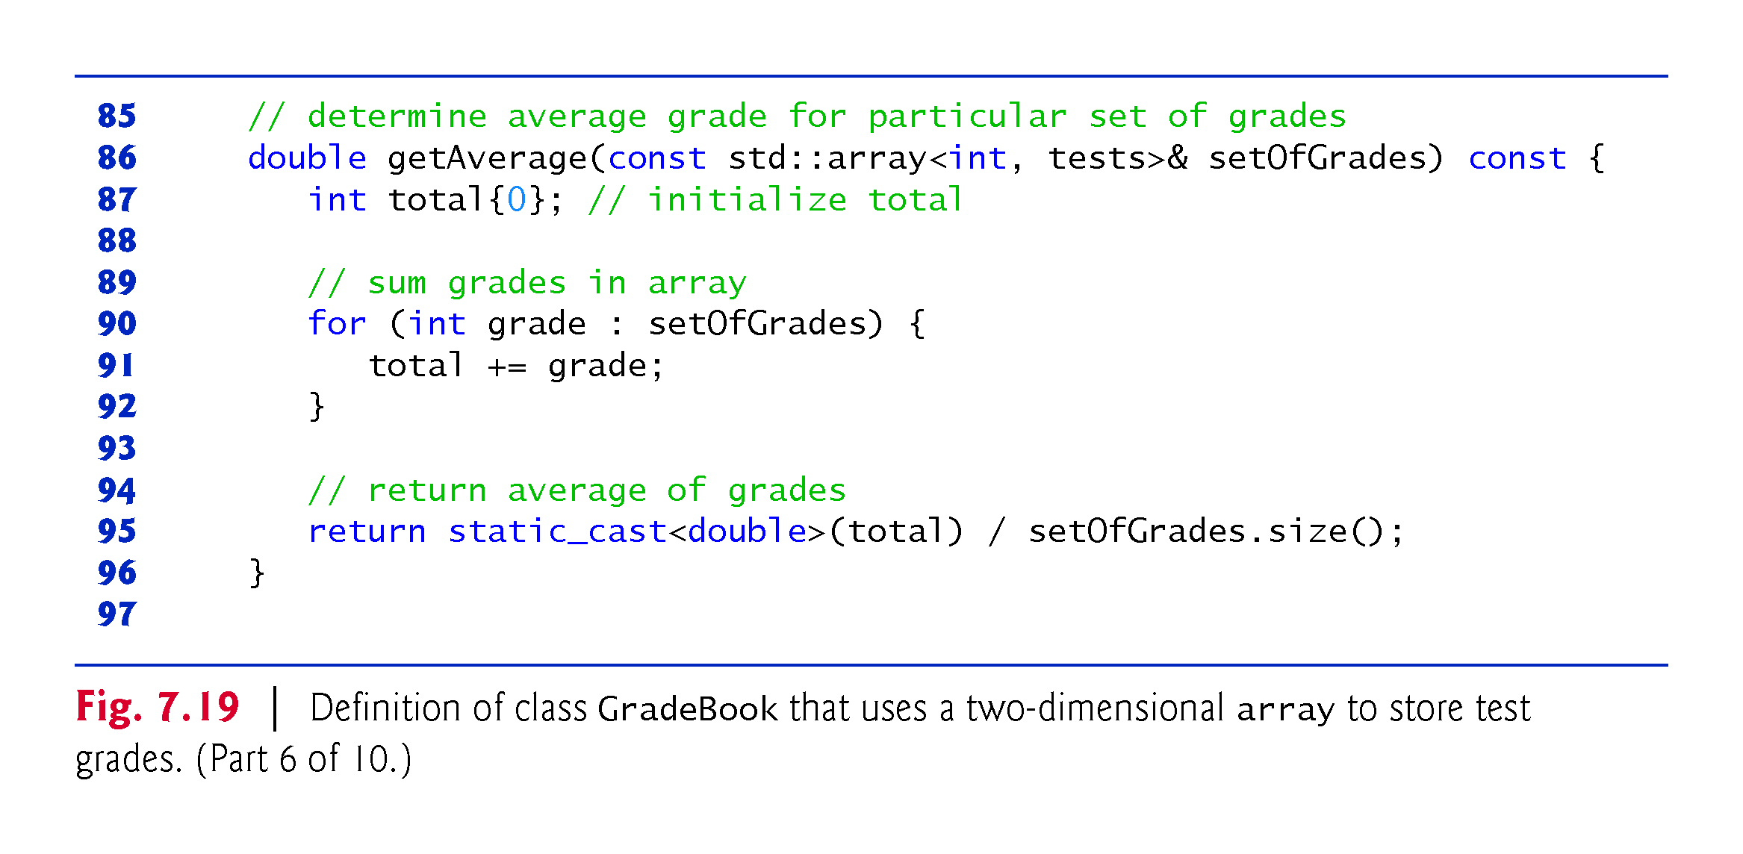

Slide 51
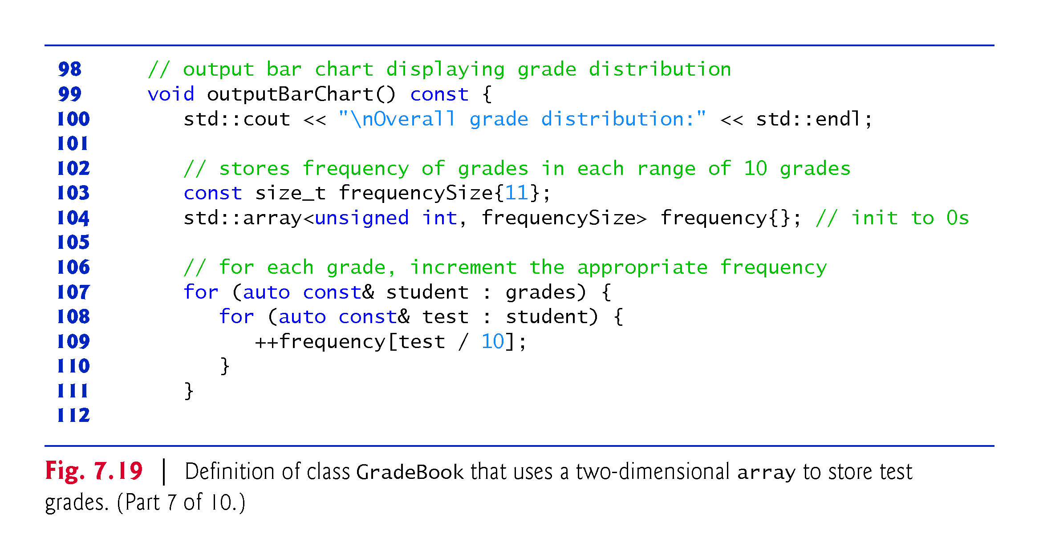

Slide 52
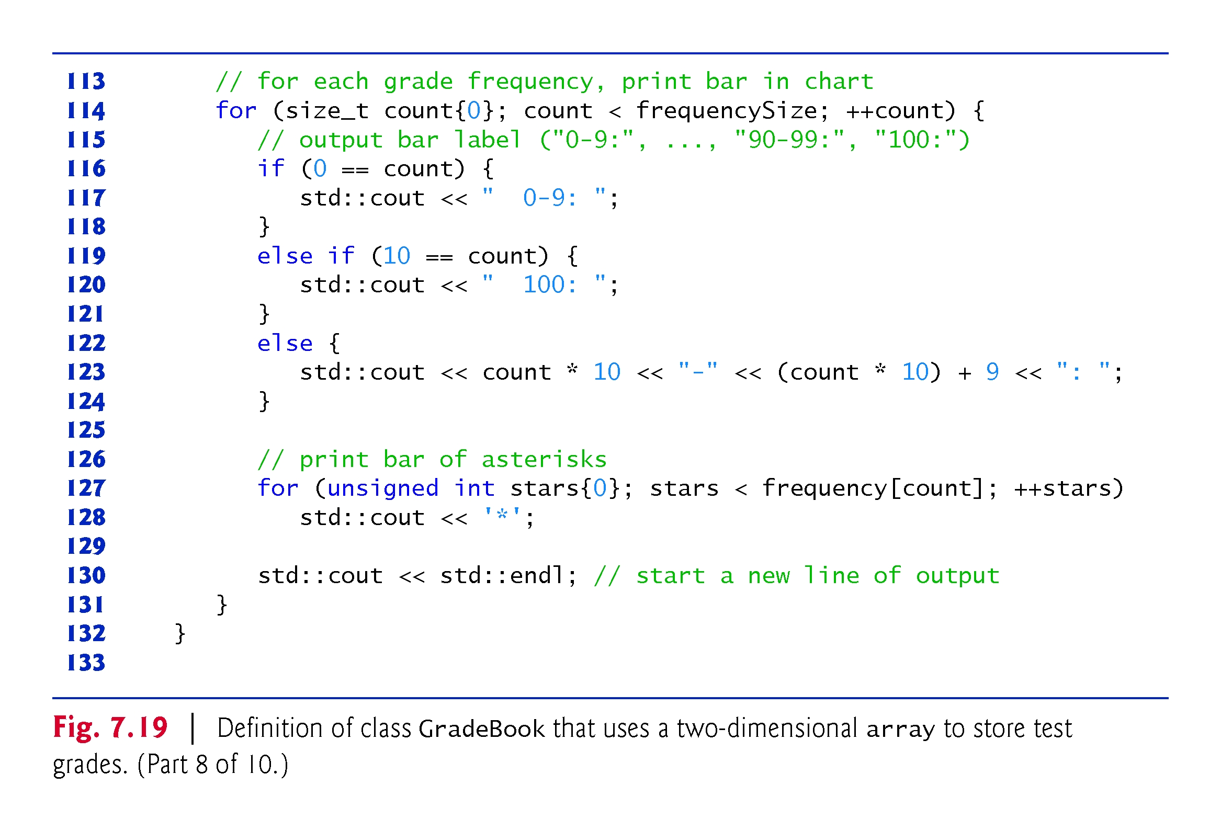

Slide 53
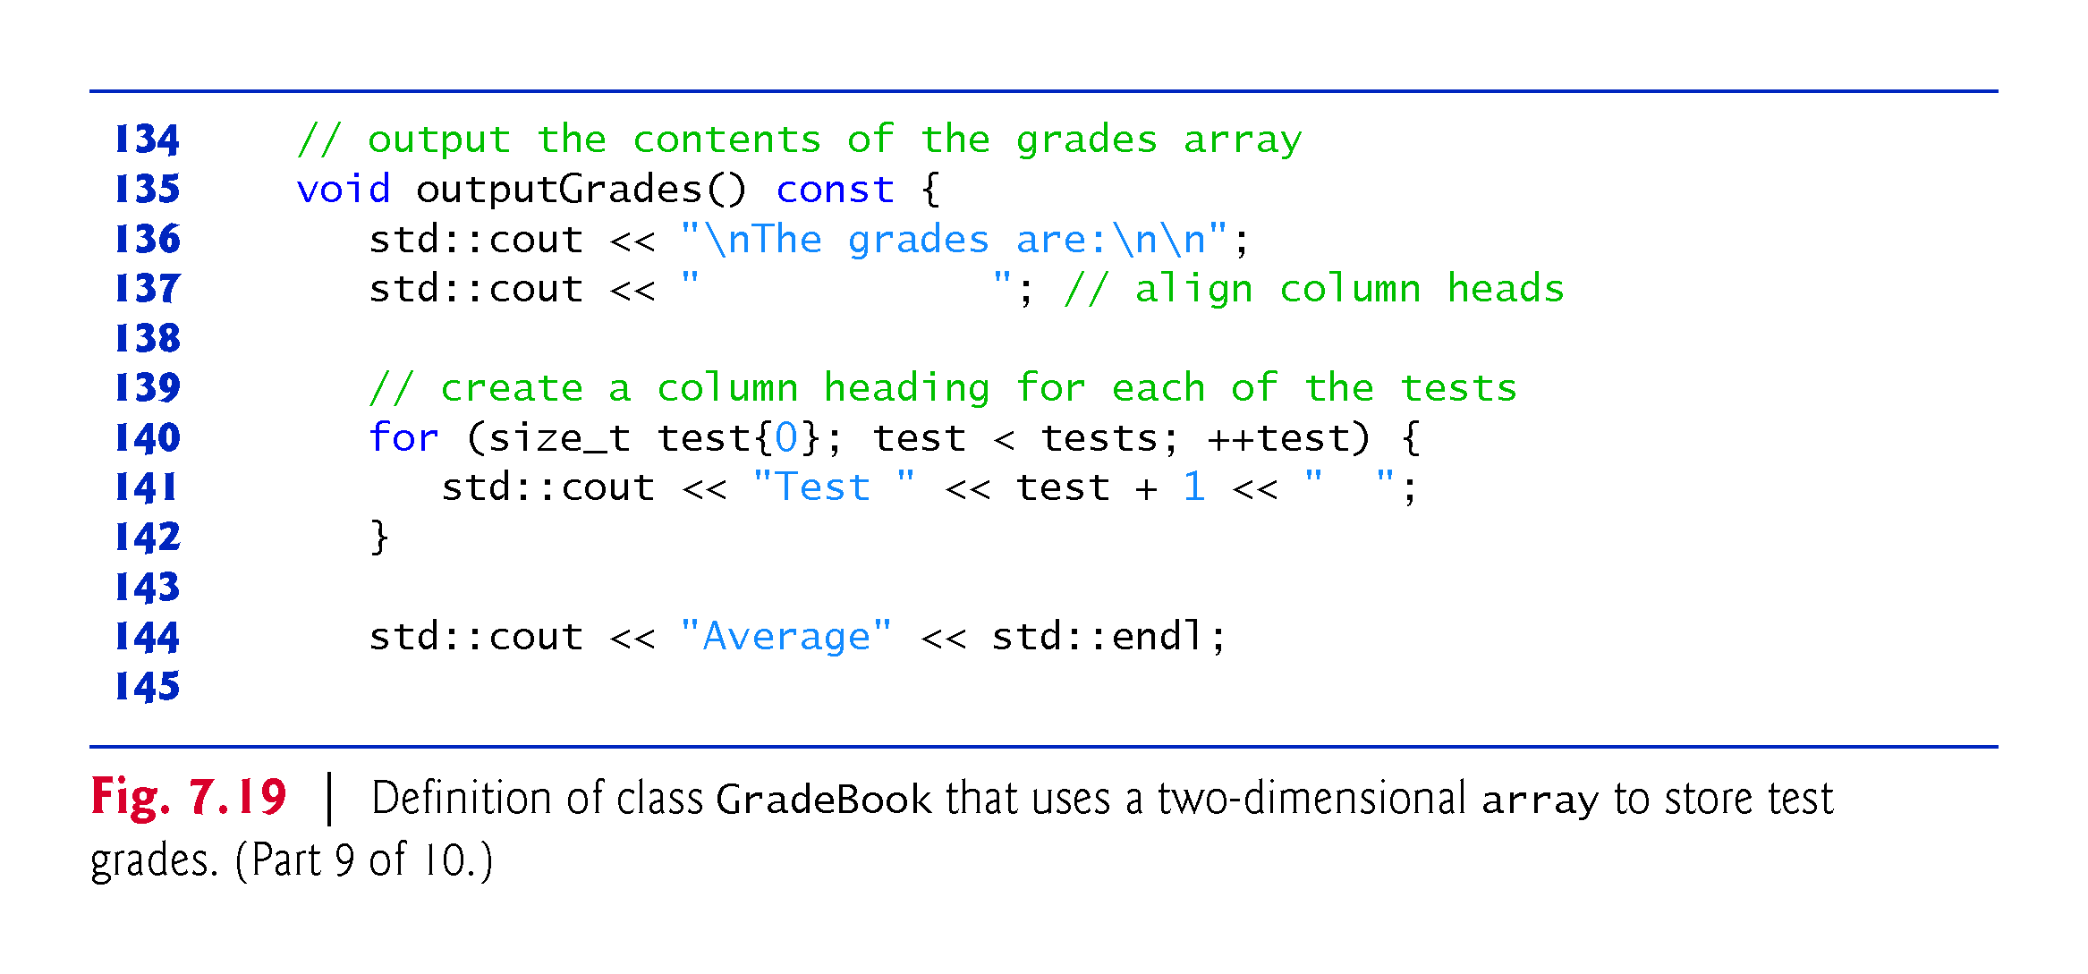

Slide 54
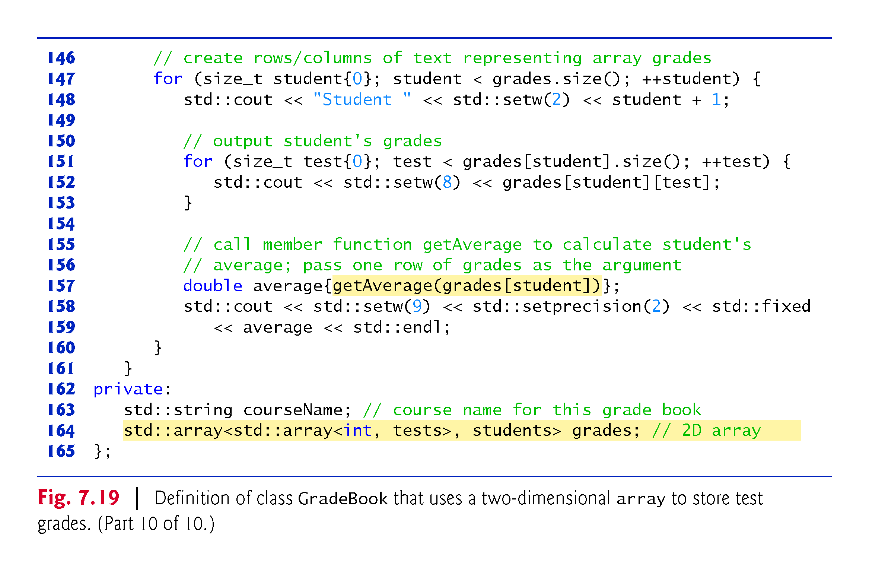

Slide 55
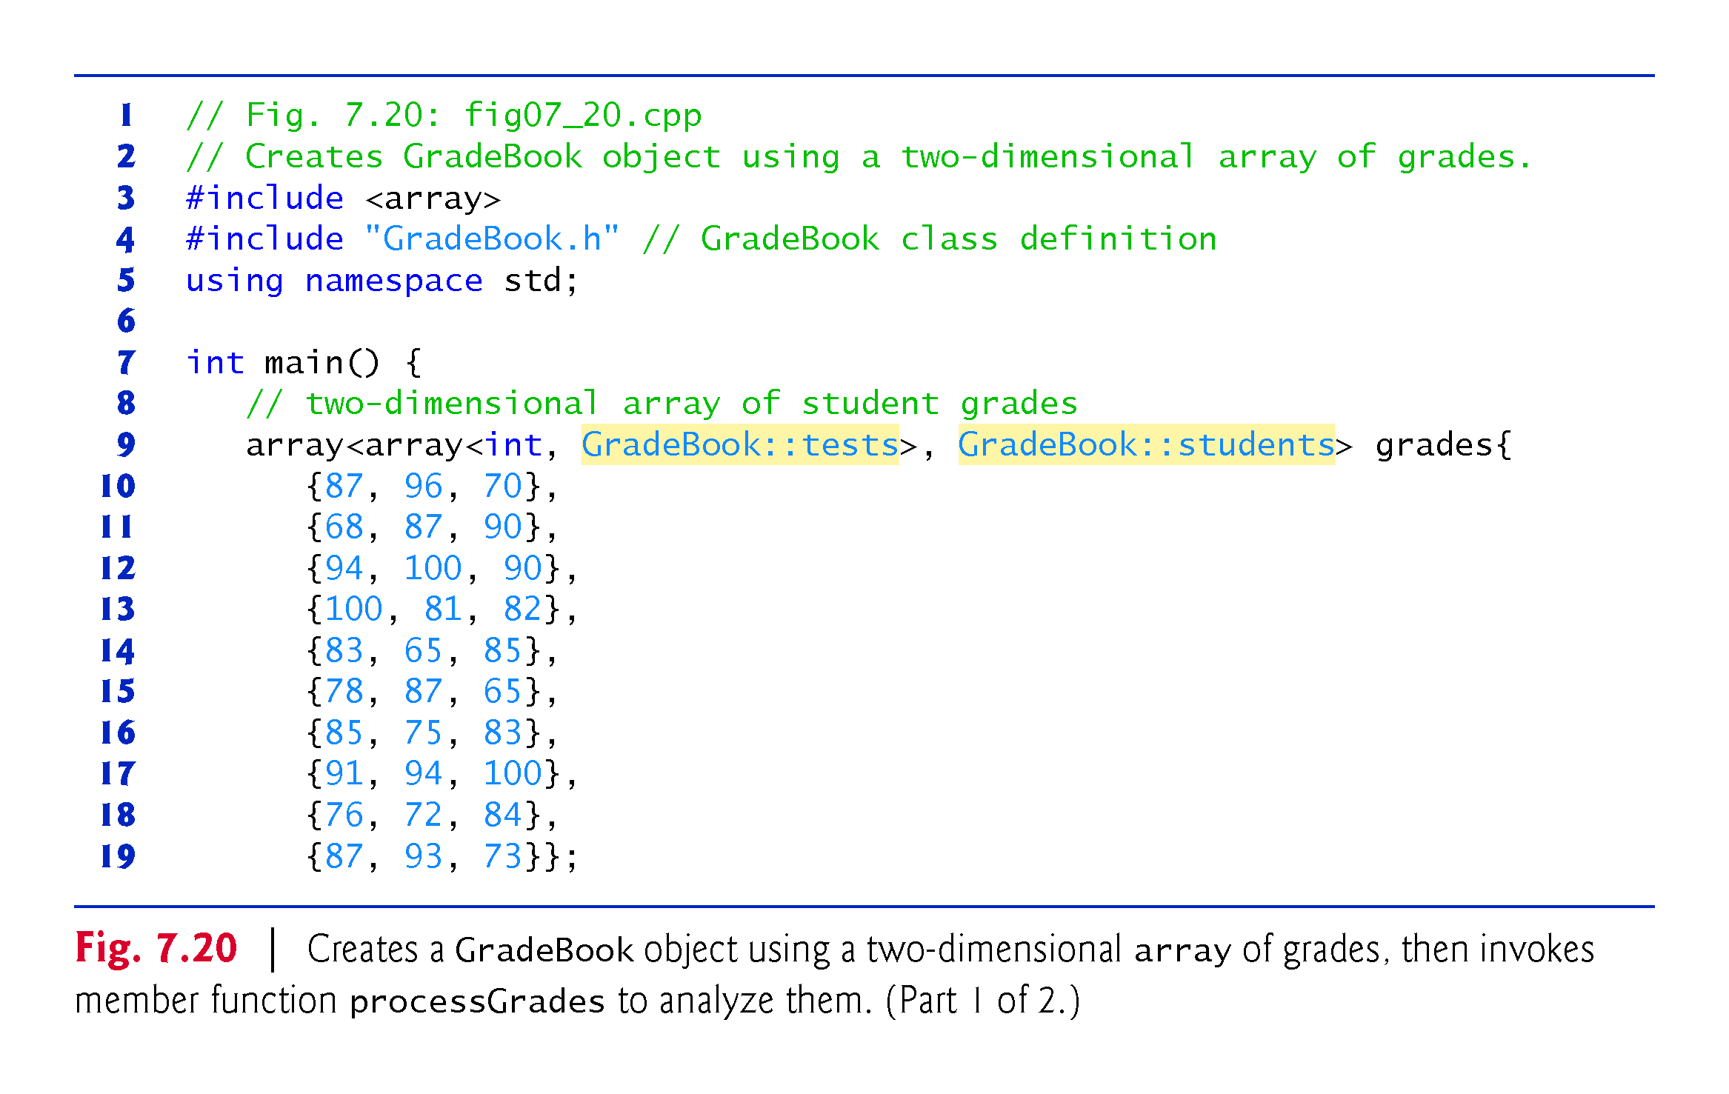

Slide 56
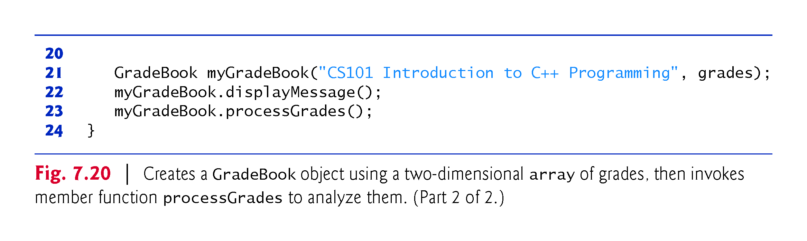

Slide 57
7.10 Introduction to C++ Standard Library Class Template vector
C++ Standard Library class template vector is similar to class template array, but also supports dynamic resizing.
Except for the features that modify a vector, the other features shown in Fig. 7.21 also work for arrays.
Standard class template vector is defined in header <vector> (line 5) and belongs to namespace std.

Slide 58
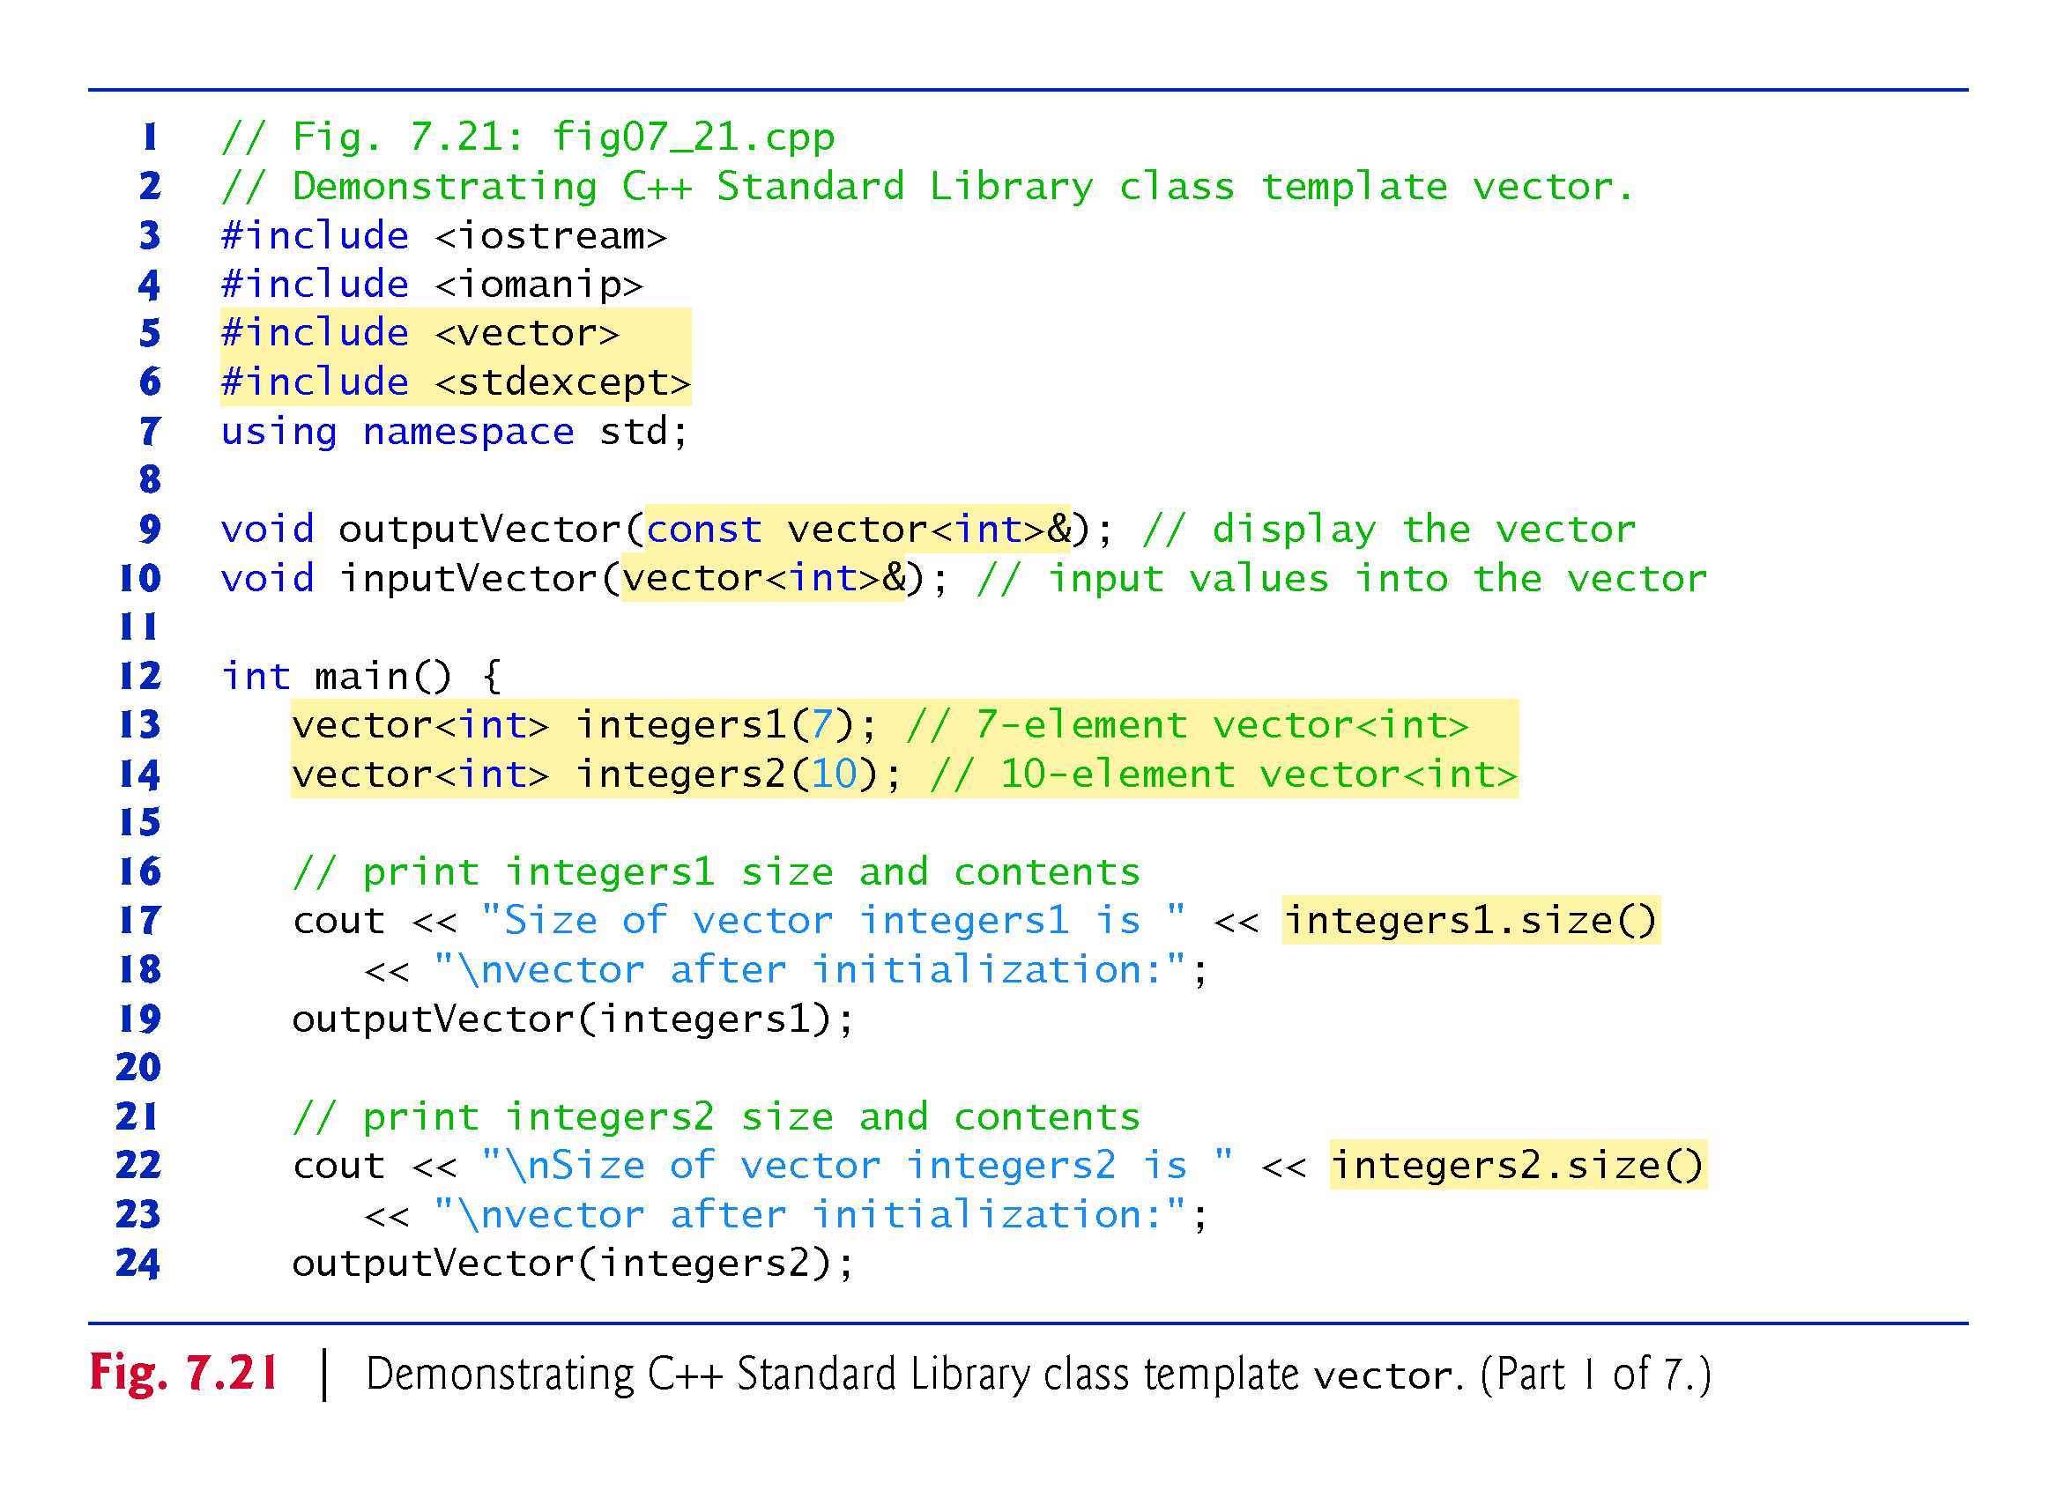

Slide 59
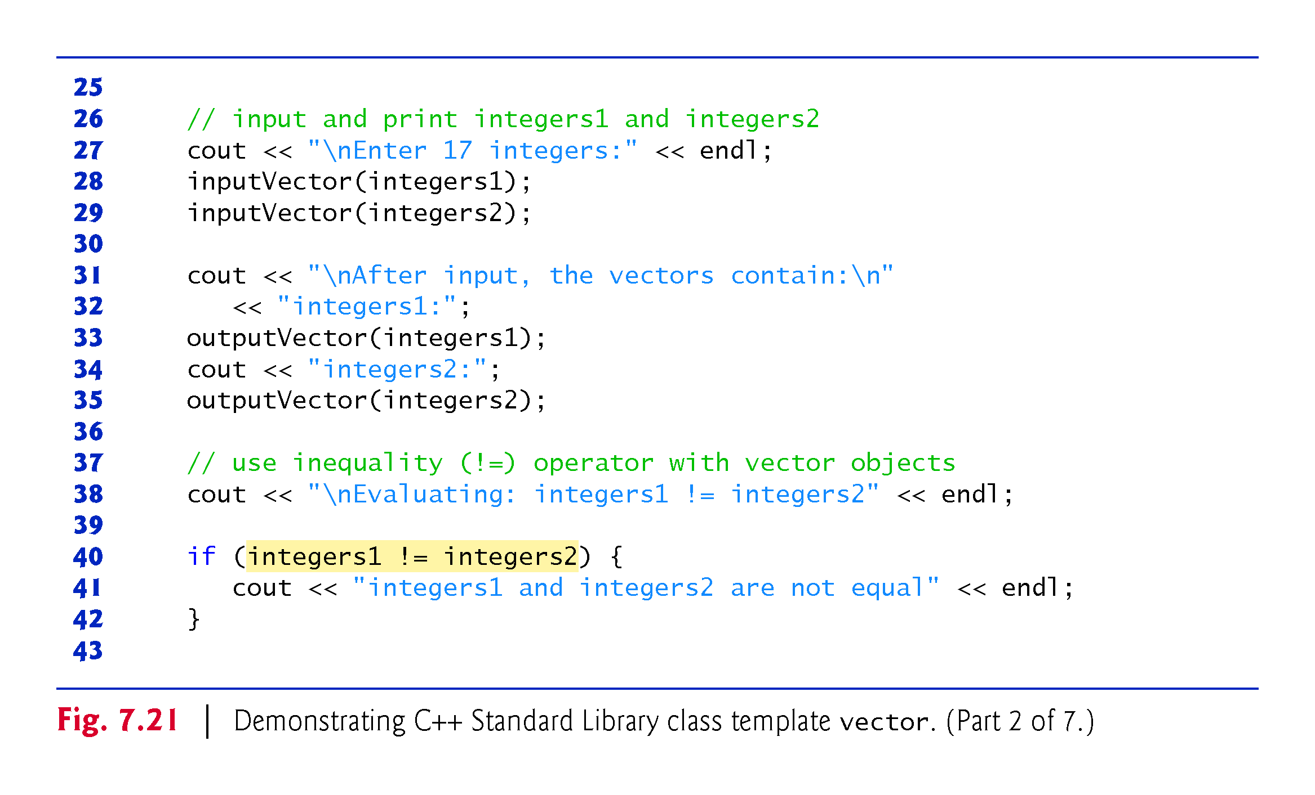

Slide 60
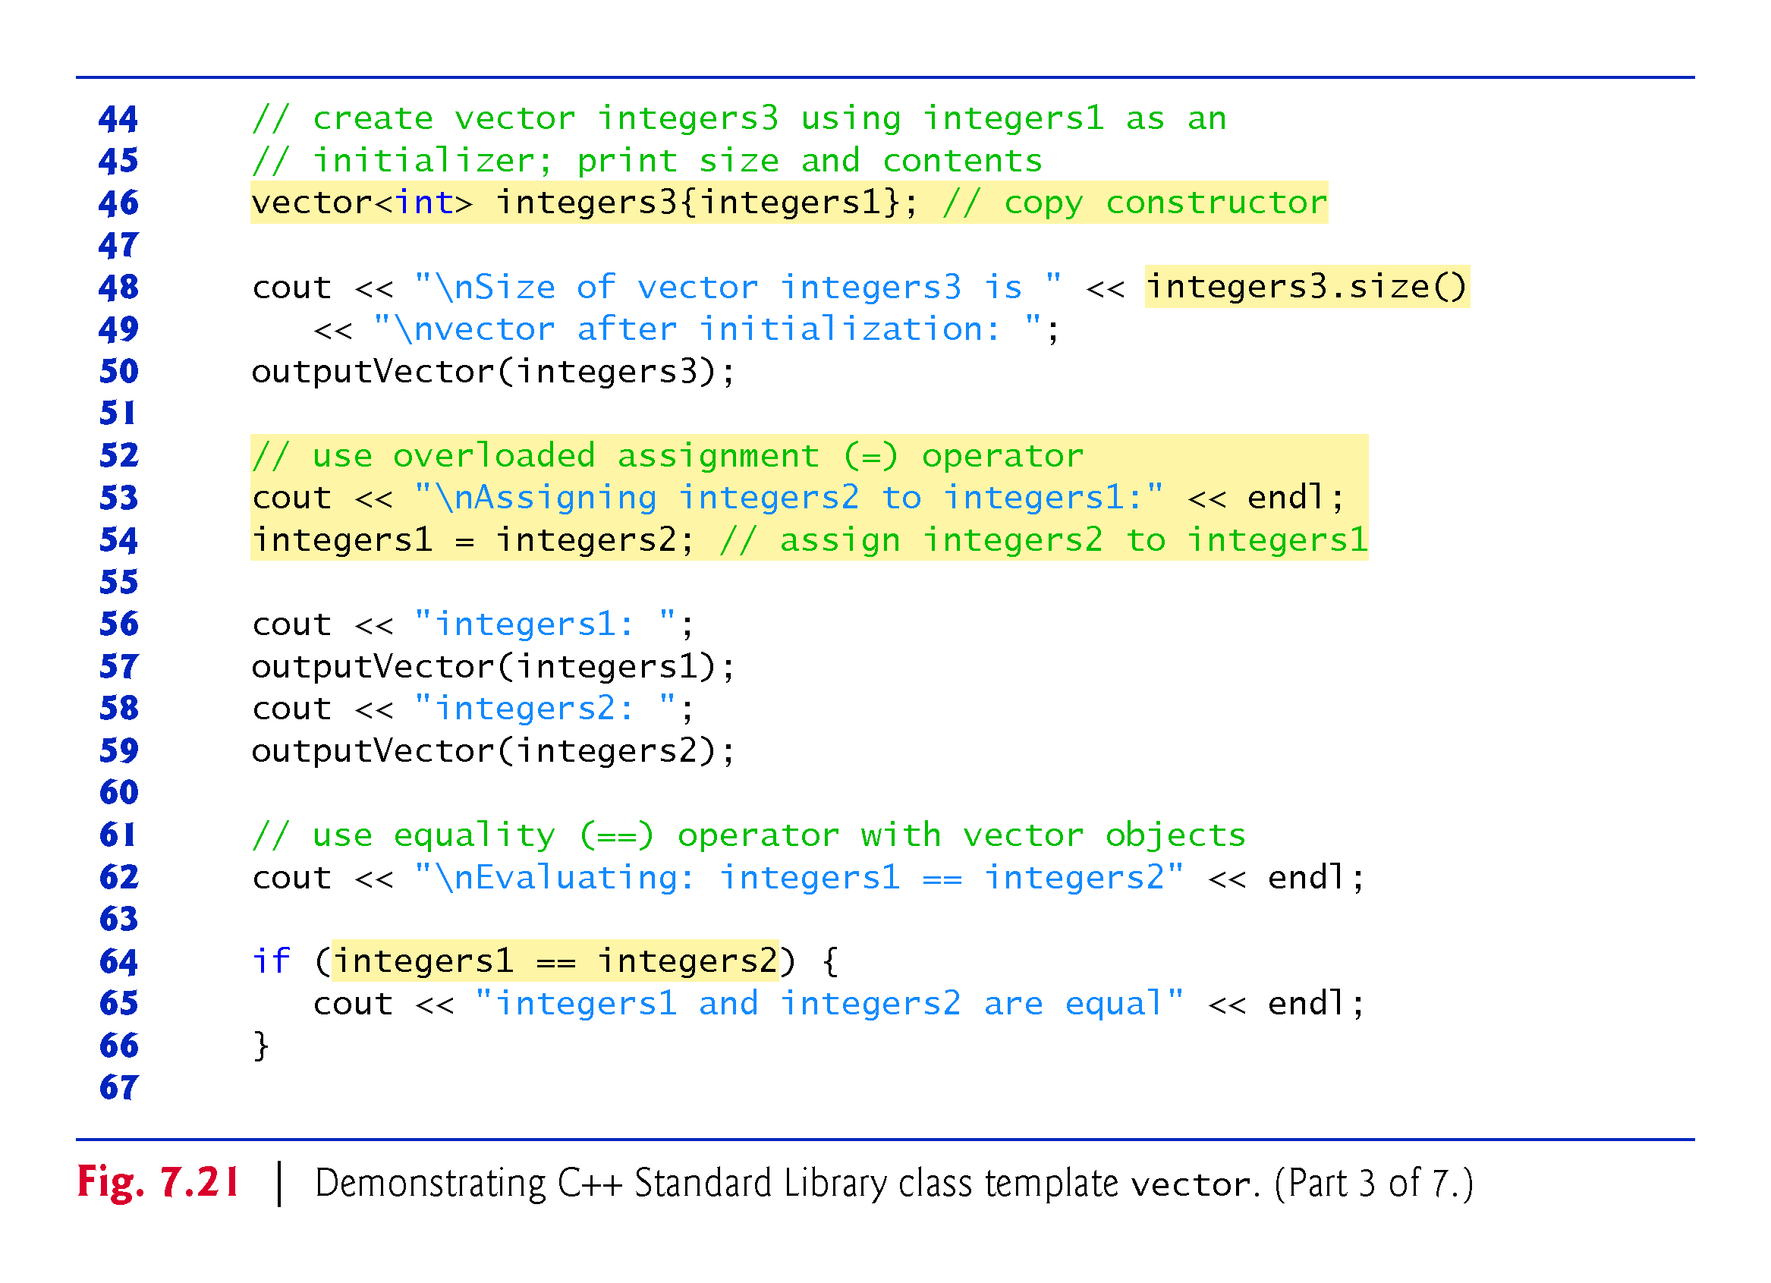

Slide 61
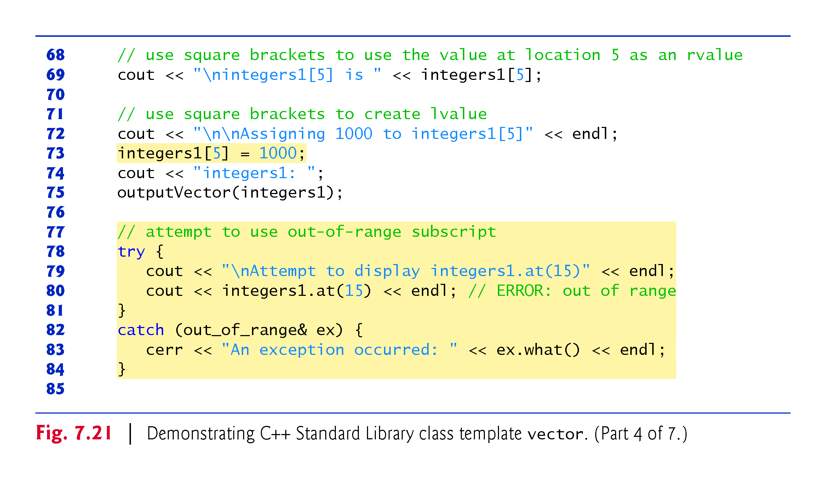

Slide 62
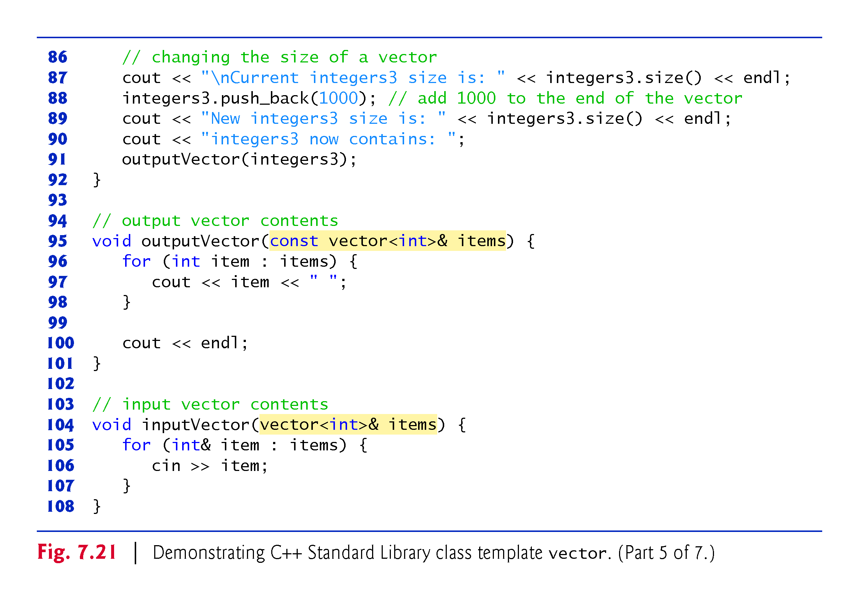

Slide 63
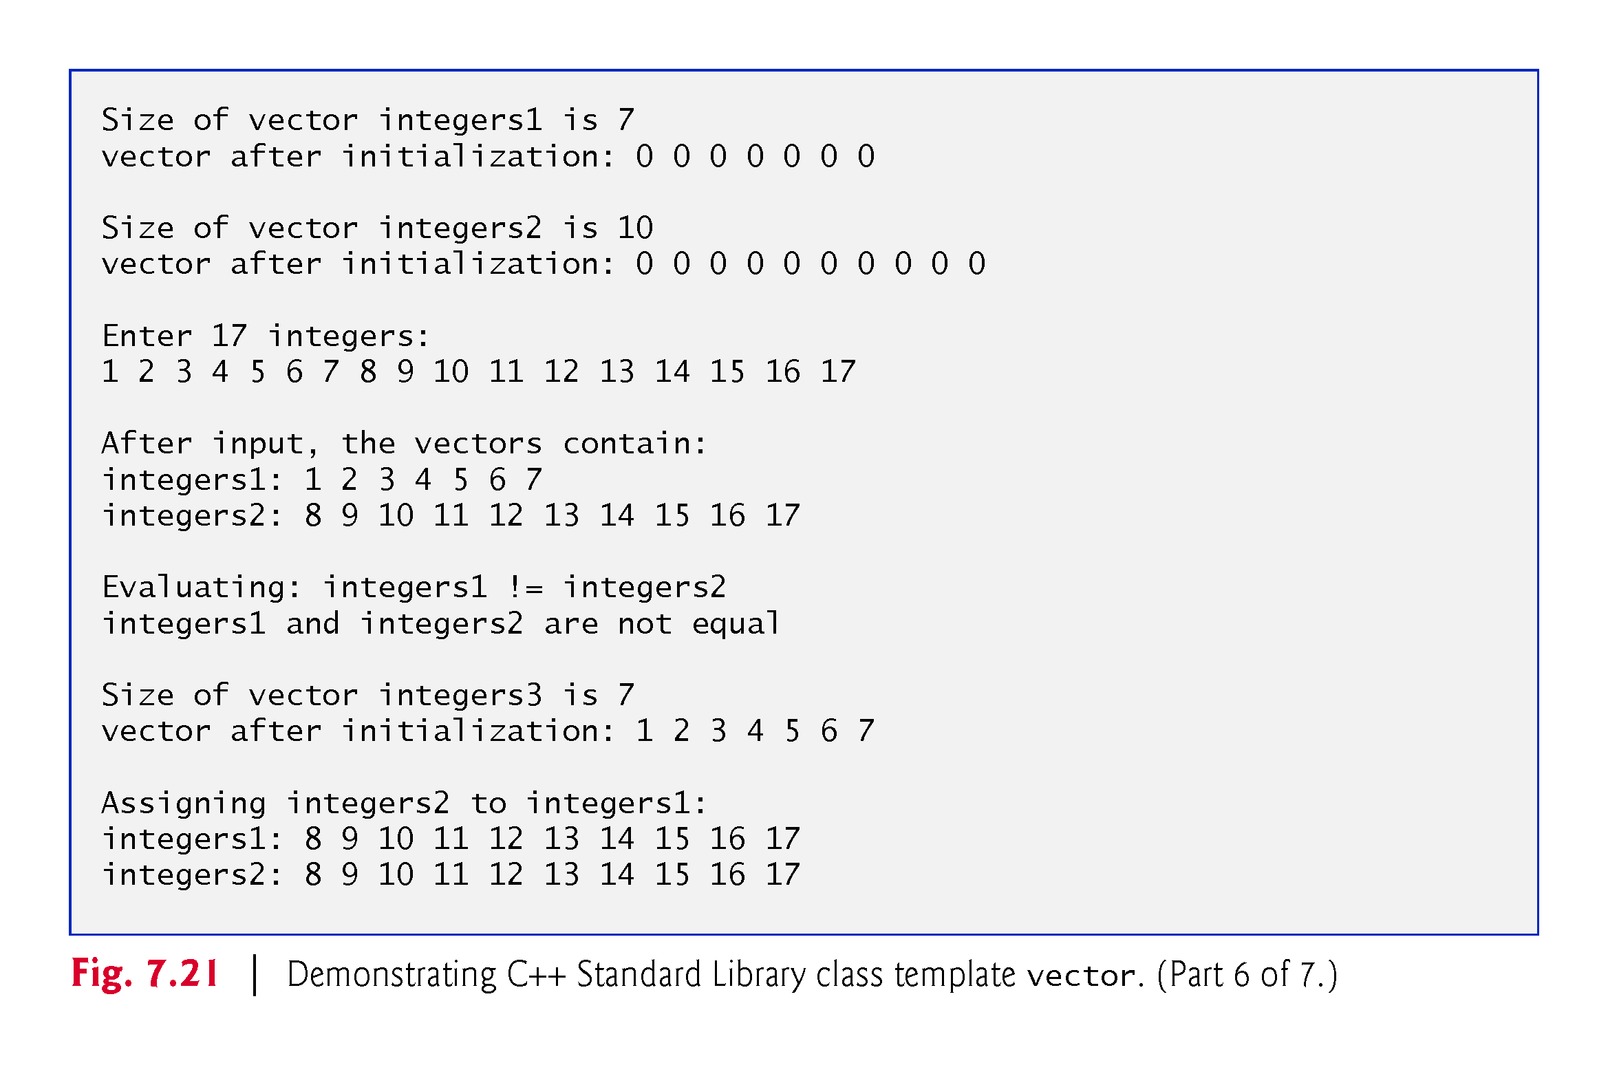

Slide 64
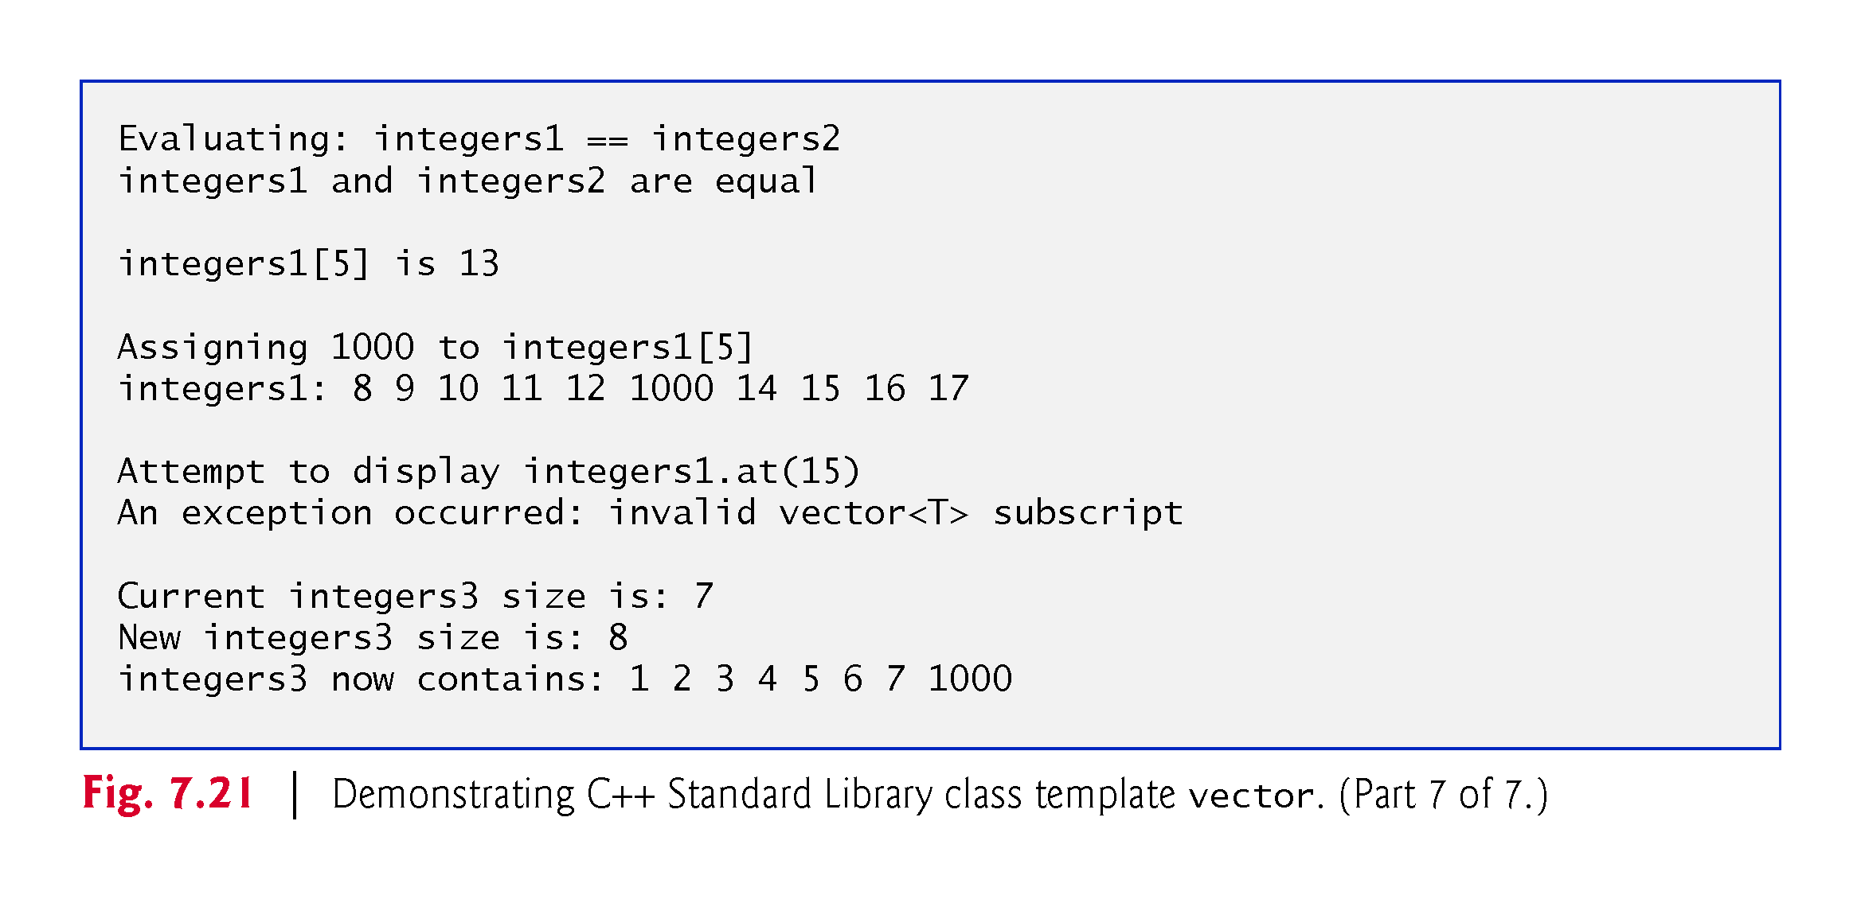

Slide 65
7.10 Introduction to C++ Standard Library Class Template vector (cont.)
By default, all the elements of a vector object are set to 0.
vectors can be defined to store most data types.
vector member function size obtain the number of elements in the vector.
As with class template array, you can also do this using a counter-controlled loop and the subscript ([]) operator.

Slide 66
7.10 Introduction to C++ Standard Library Class Template vector (cont.)
Notice that we used parentheses rather than braces to pass the size argument to each vector object’s constructor.
When creating a vector, if the braces contain one value of the vector’s element type, the braces are treated as a one-element initializer list, rather than a call to the constructor that sets the vector’s size.
The following declaration actually creates a one-element vector<int> containing the int value 7, not a 7-element vector
vector<int> integers1{7};

Slide 67
7.10 Introduction to C++ Standard Library Class Template vector (cont.)
You can use the assignment (=) operator with vector objects.
As is the case with arrays, C++ is not required to perform bounds checking when vector elements are accessed with square brackets.
Standard class template vector provides bounds checking in its member function at (as does class template array).

Slide 68
7.10 Introduction to C++ Standard Library Class Template vector (cont.)
An exception indicates a problem that occurs while a program executes.
The name “exception” suggests that the problem occurs infrequently.
Exception handling enables you to create fault-tolerant programs that can resolve (or handle) exceptions.
When a function detects a problem, such as an invalid array subscript or an invalid argument, it throws an exception—that is, an exception occurs.

Slide 69
7.10 Introduction to C++ Standard Library Class Template vector (cont.)
To handle an exception, place any code that might throw an exception in a try statement.
The try block contains the code that might throw an exception, and the catch block contains the code that handles the exception if one occurs.
You can have many catch blocks to handle different types of exceptions that might be thrown in the corresponding try block.
The vector member function at provides bounds checking and throws an exception if its argument is an invalid subscript.
By default, this causes a C++ program to terminate.

Slide 70
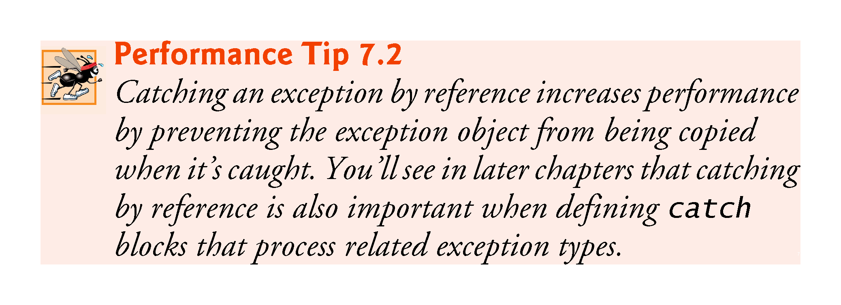

Slide 71
7.10 Introduction to C++ Standard Library Class Template vector (cont.)
Changing the Size of a vector
One of the key differences between a vector and an array is that a vector can dynamically grow and shrink as the number of elements it needs to accommodate varies.
To demonstrate this, line 88 shows the current size of integers3, line 89 calls the vector’s push_back member function to add a new element containing 1000 to the end of the vector and line 90 shows the new size of integers3.
Line 92 then displays integers3’s new contents.

Slide 72
7.10 Introduction to C++ Standard Library Class Template vector (cont.)
C++11: List Initializing a vector
Many of the array examples in this chapter used list initializers to specify the initial array element values.
C++11 also allows this for vectors (and other C++ Standard Library data structures).

